Slide 1
Moose Logistics, LLC is the JV Partner and
Distributor for Great Façade Material to the USA
Metal Composite Panel
FR A class

Slide 2
01
Company Introduction
ALUBOND （Jiangsu）is a JV company between USA and China investment.
ALUBOND(Jiangsu) mainly develop and manufact metal composite panel for building material & other application.

Slide 3
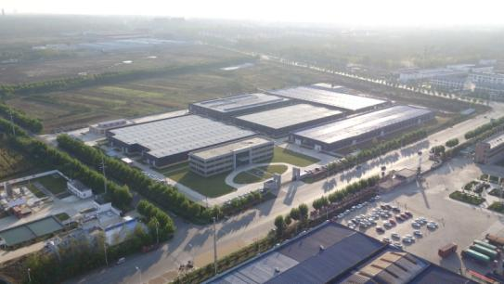
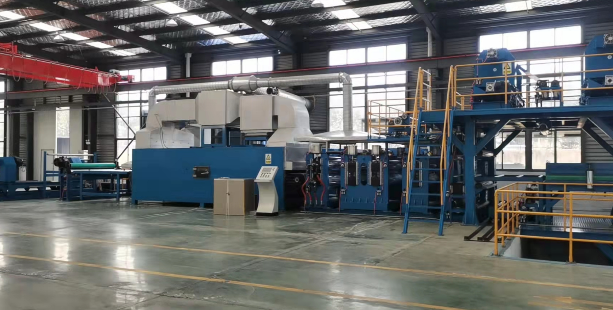
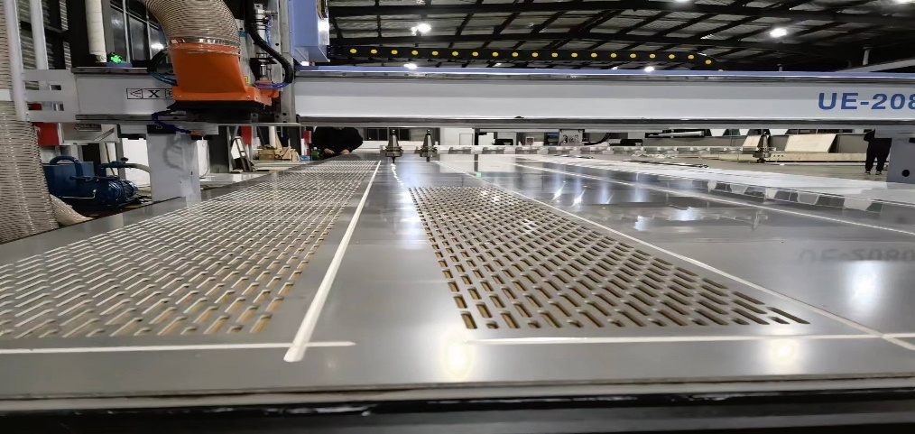
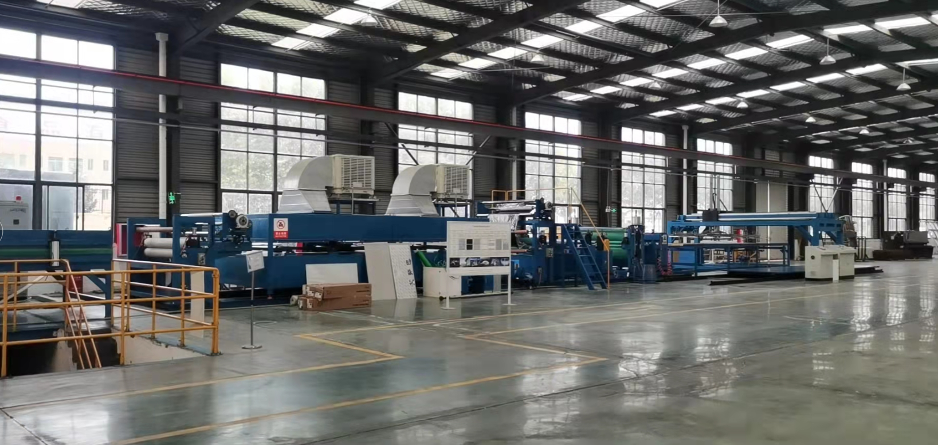
Factory view
标题文字添加
ALUBOND(Jiangsu) had the full facility for metal composite panel which including manufacturing and further process. metal composite panel is available for international business.

Slide 4
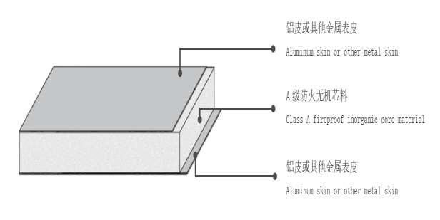
02
Product introduction
Shape : It is two metal skin with mineral core bonded sandwich panel which is non-combustible system.
FR performance: It is a FR A class level composite panel which no limit for height or application area.
metal skin文字添加
Mineral core文字添加
metal skin文字添加

Slide 5
Surface Selection
03
Al composite：paint coating（general solid color, metallic color, high gloss , prismatic etc), artificial paint color: (wood、stone 、cement etc）、anodizing (low gloss, high gloss); film(interior, exterior)
Stainless steel composite：sand, mirror, brush ,color
Ti-zinc composite ：blue gray、deep gray
Copper composite：red copper, brass (nature or aged)
TI composite：pure Ti

Slide 6
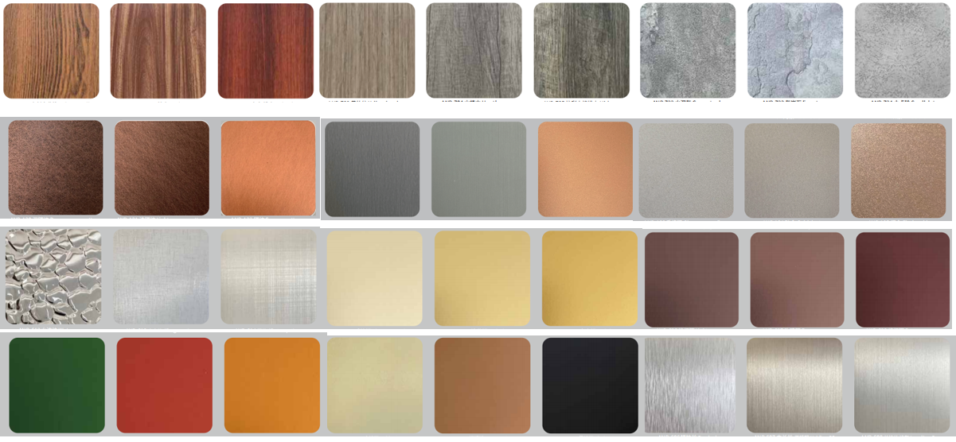
Pattern : It is not only metal type and color with many options. There are also many type of patterns available . Please contact us for color chart.

Slide 7
Typical Characteristics
04
Flame retardant
Non combustible
flame retardant
Big size
2000*8000 available
Super flat
Big size
Green
Color
Light
Options
impact
Shape
Economy
Durability
Super flat
Color consistencity

Slide 8
Advantages：---FR A class，non-combustible and Flame retardant
Non-combustible, no fire risk
Stay over >1200 C high temperature
Better performance than solid Al panel
Meet : ASTM E119-12, 2 hours fire resistance
标题文字添加
标题文字添加

Slide 9
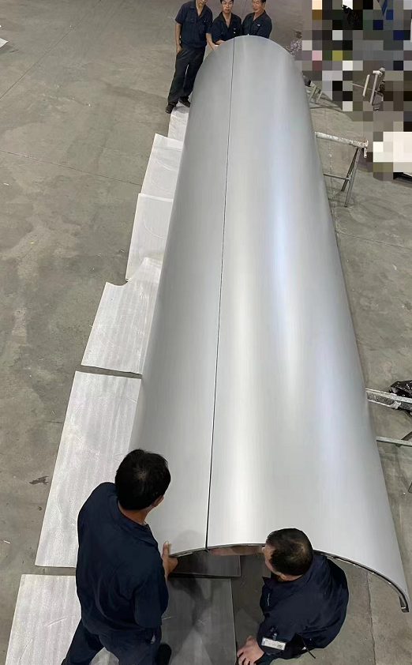
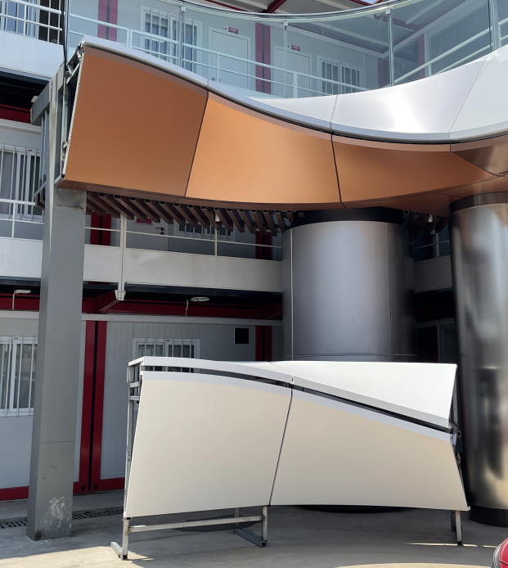
Curve shape by composite panel
Composite panel make different curve shape reach a good result

Slide 10
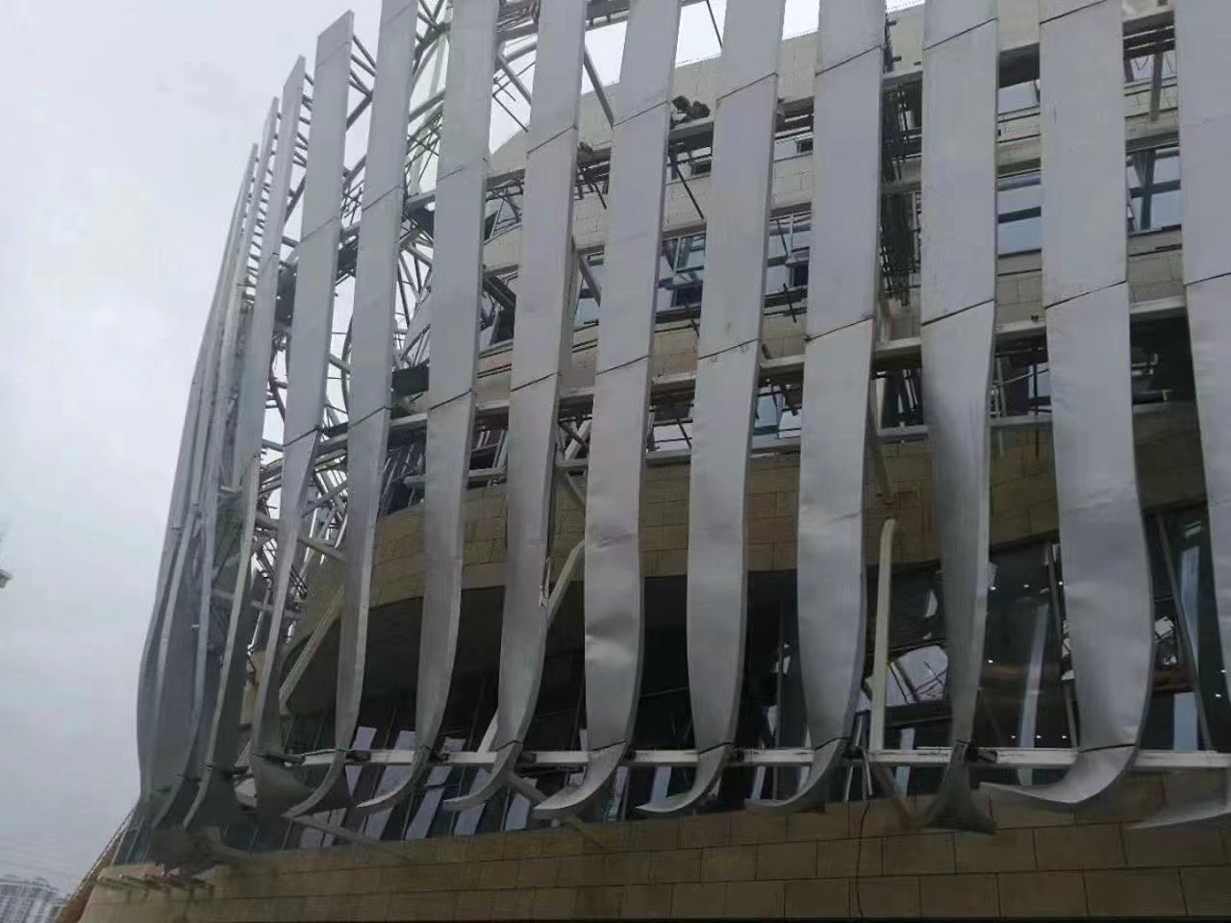
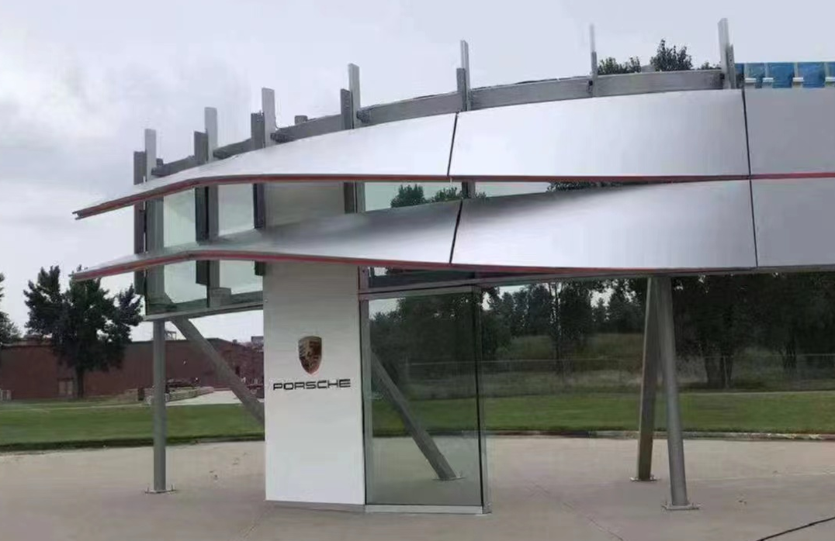
Compare between solid panel and composite panel
3mm solid panel
4mm composite panel

Slide 11
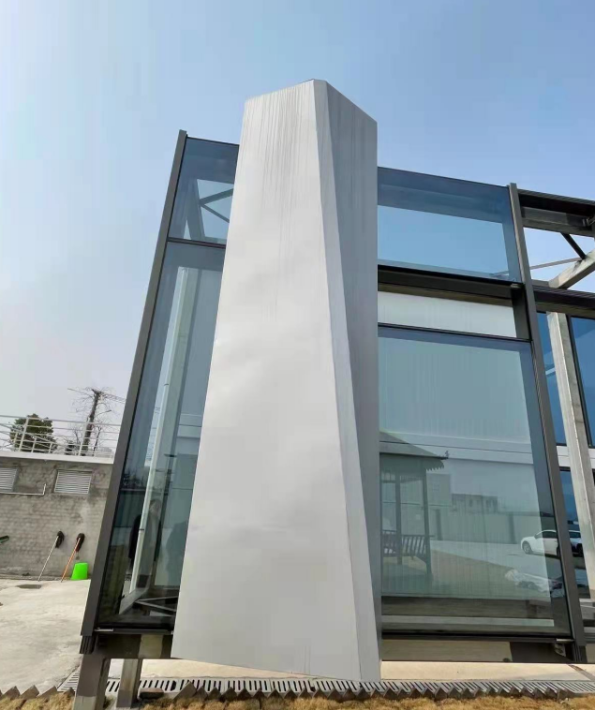
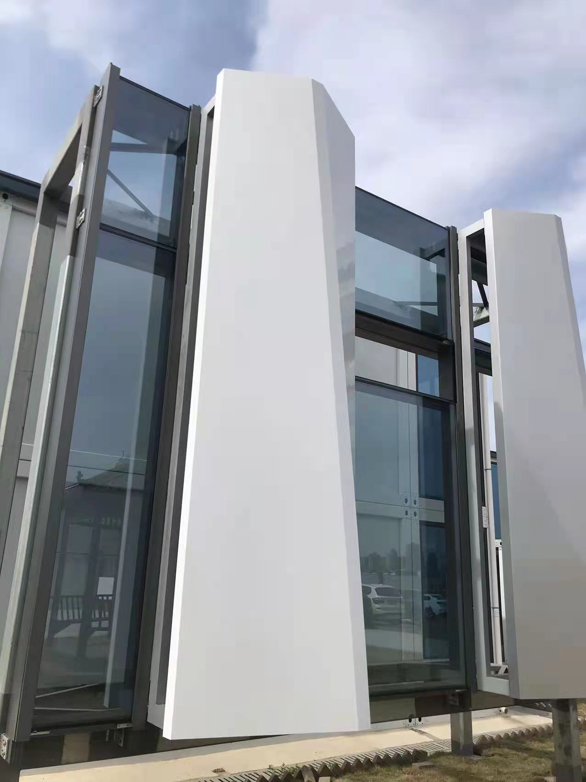
Compare between solid panel and composite panel
3mm solid panel make VMU
4mm composite panel make same VMU

Slide 12
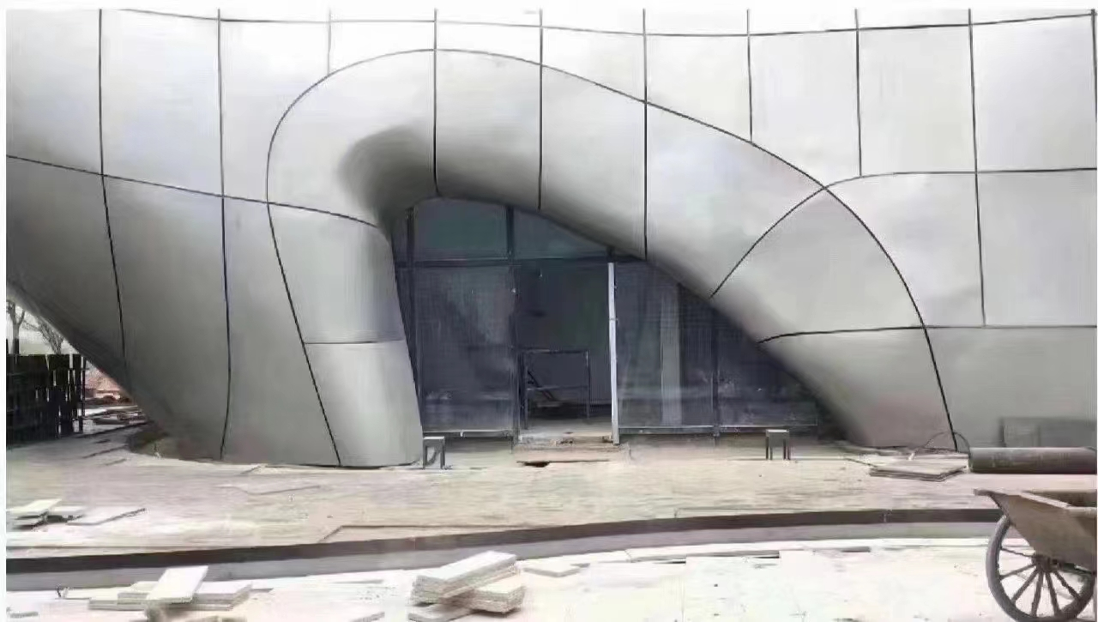
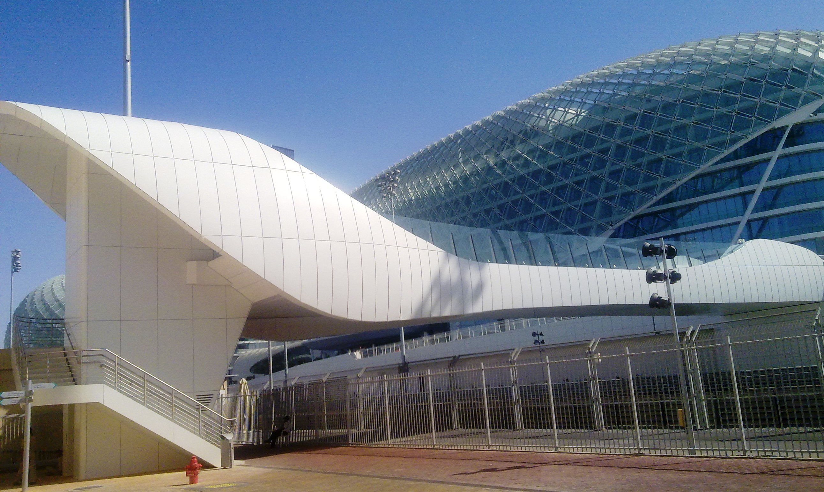
Compare between solid panel and composite panel
3mm solid panel
4mm composite panel

Slide 13
Typical process—
Take copper composite panel as sample
05
Characteristics：
thickness：4mm
FR class：FR A2
top skin：0.5mm cooper+coating
core：mineral
bottom skin：coated 0.7mm AL skin
Specification：(limited by copper coil width)
Standard size：980mm*3200mm
Max size：980mm*7000mm
Substrate: red cooper, brass

Slide 14
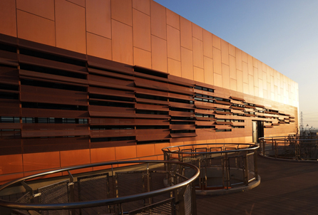
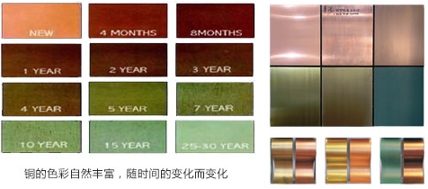
Original state of copper material changes until a stable surface is formed.
For example, the variation of red copper over time in the above figure.
At present, with the progress of materials science, we can pre oxidize copper in advance to achieve the desired color during the copper change process. Through coating protection measures, the appearance effect is relatively fixed for a period of more than 10 years.
As option, we could also offer original copper or brass as the skin to present the nature change .

Slide 15
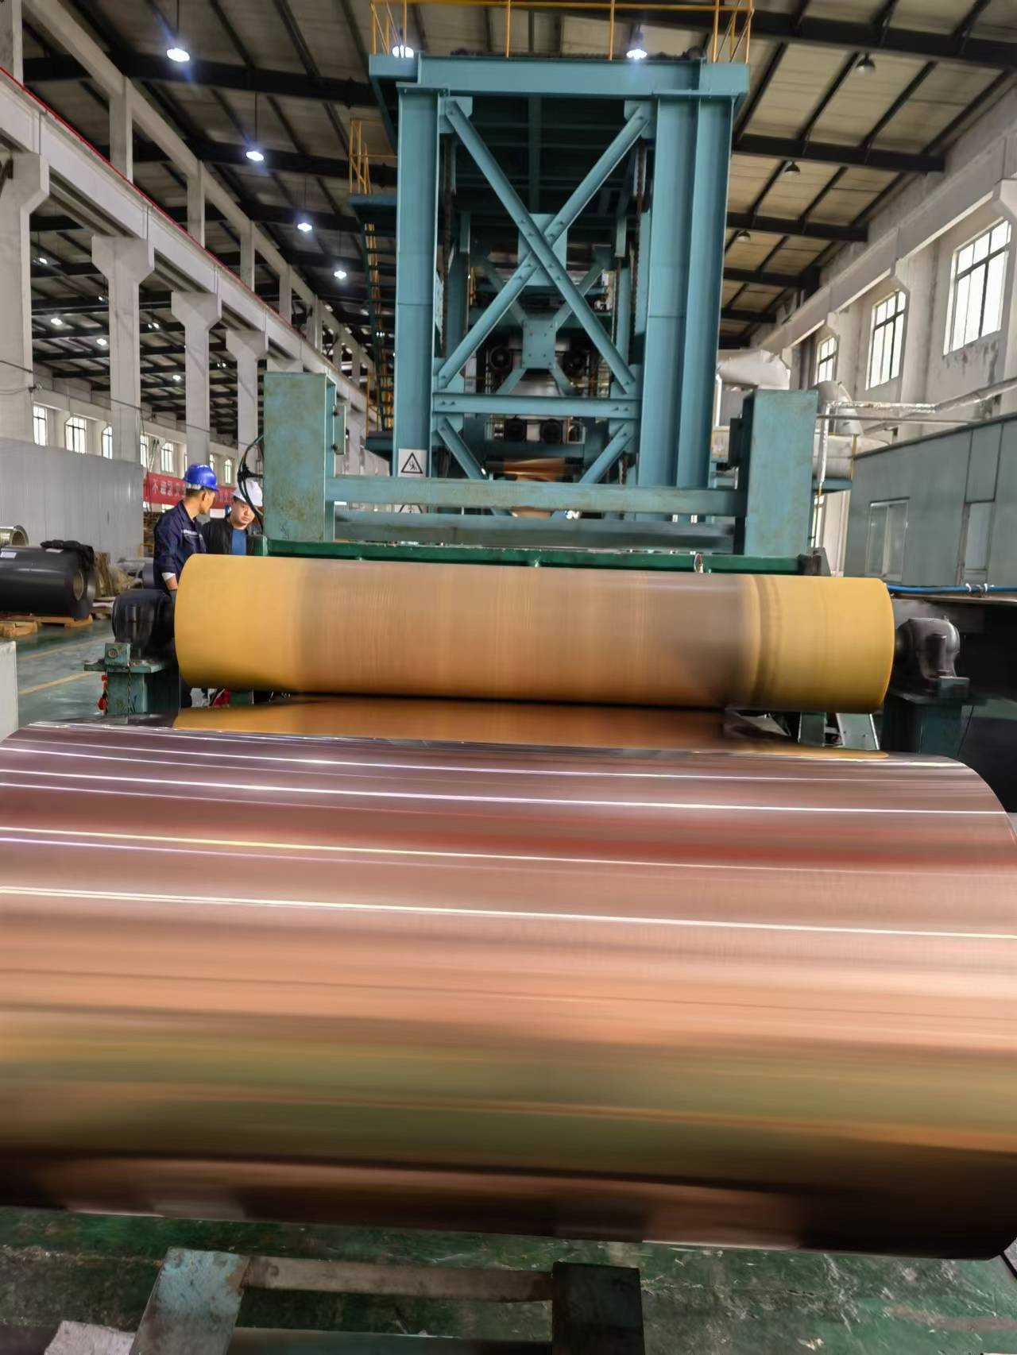
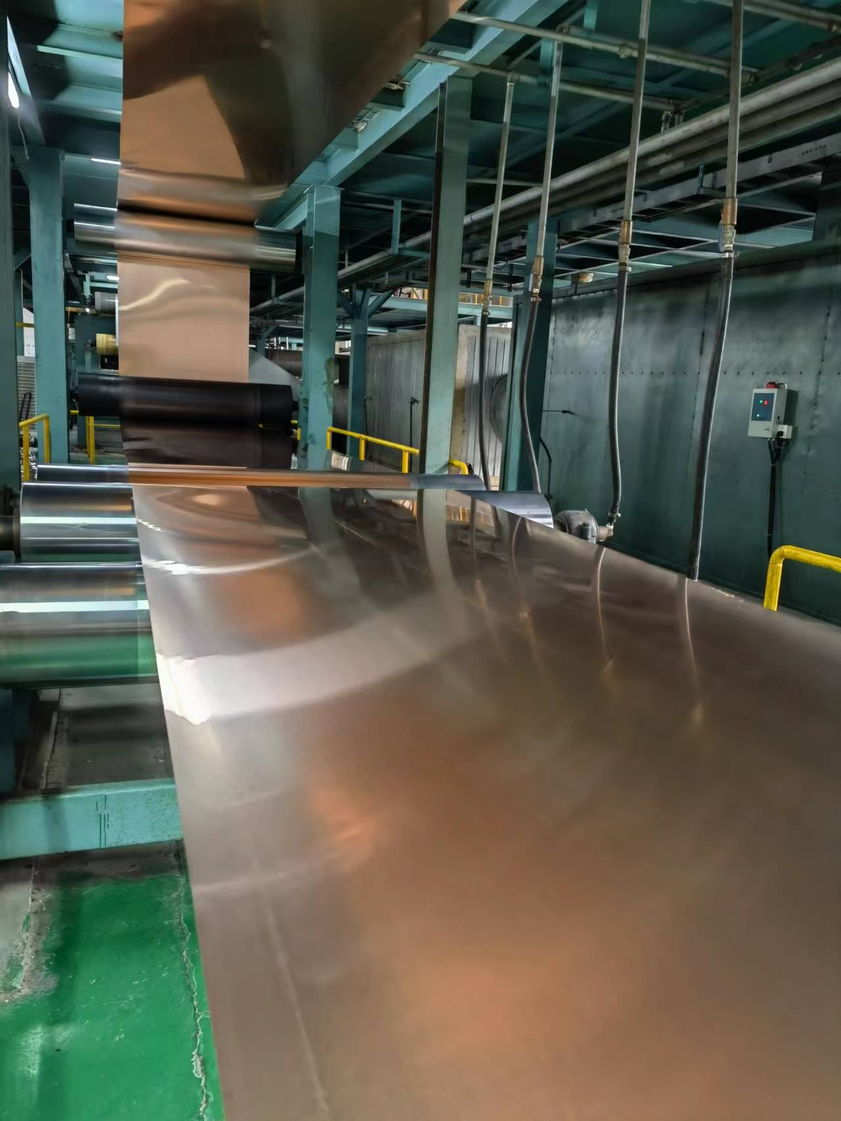
Brief of process – copper composite panel making
Original copper coil be handled by clean and pretreatment process make it ready for bonding.

Slide 16
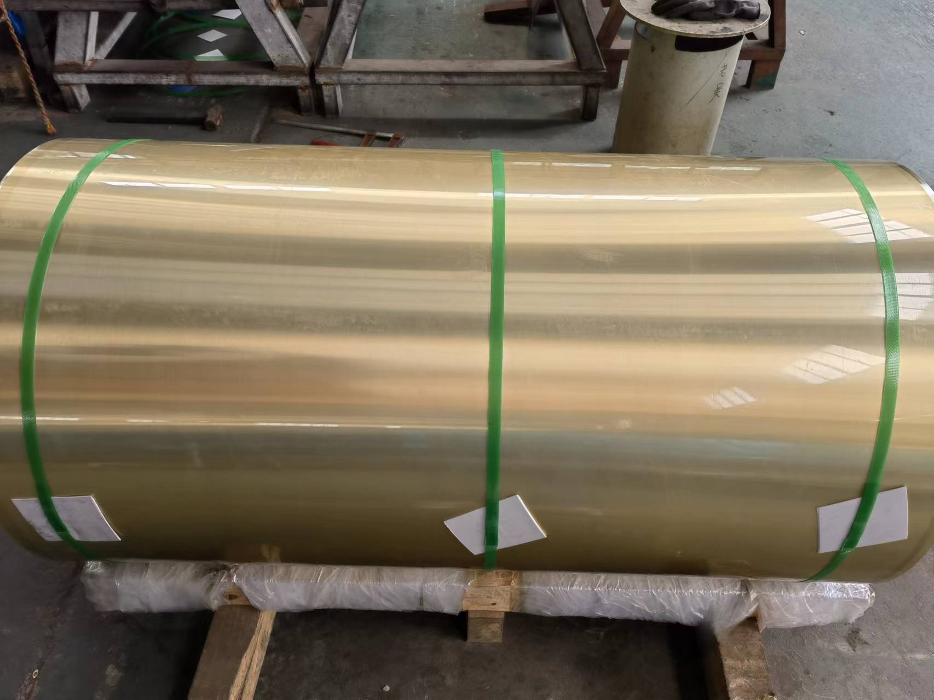
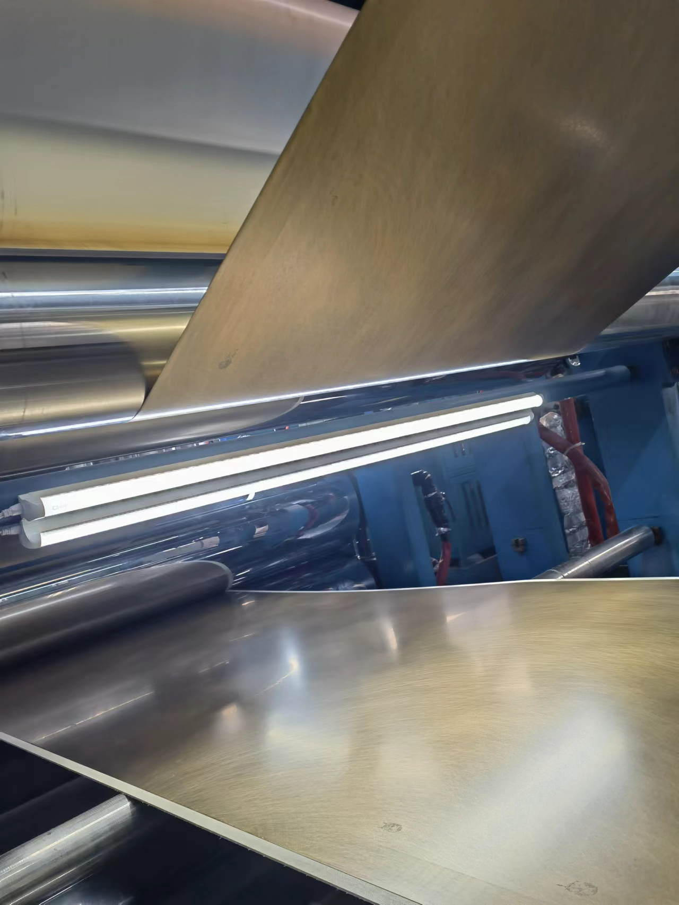
Original brass coil be handled by clean and pretreatment process make it ready for bonding. Then put coil through composite machine.

Slide 17
Brass coil be loaded through composite machine bonding with core and bottom skin by high temperature and high pressure.

Slide 18
Bonded panel go through cooling and flatting and cutting then be put as pallet.

Slide 19
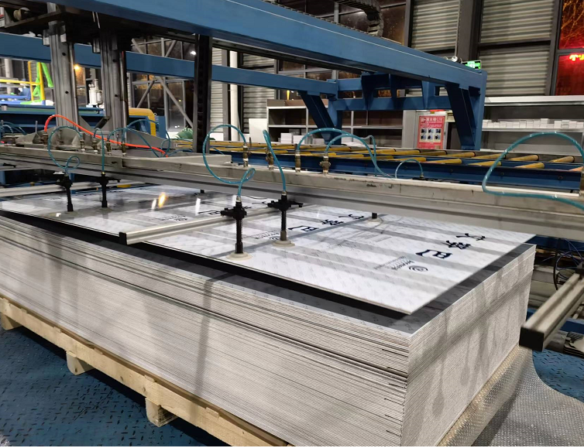
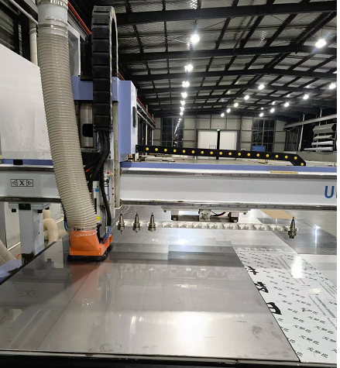
Pallet of the made sheets
Lay the sheet on CNC table ready for groove and cutting

Slide 20
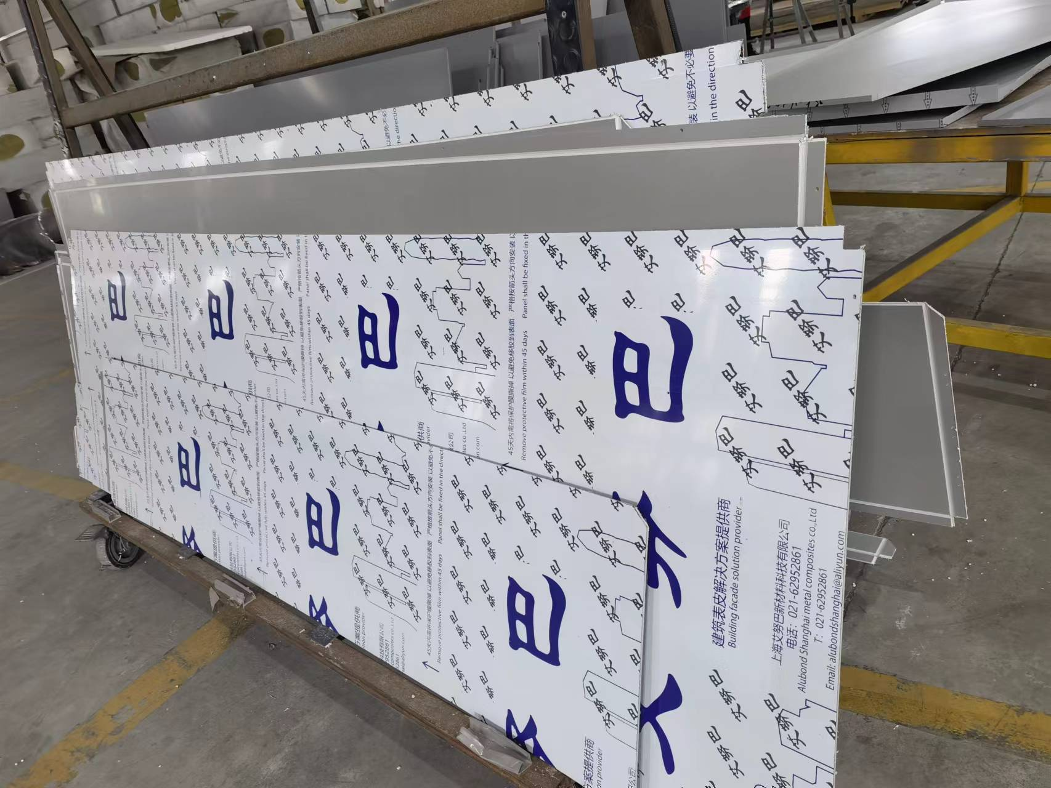
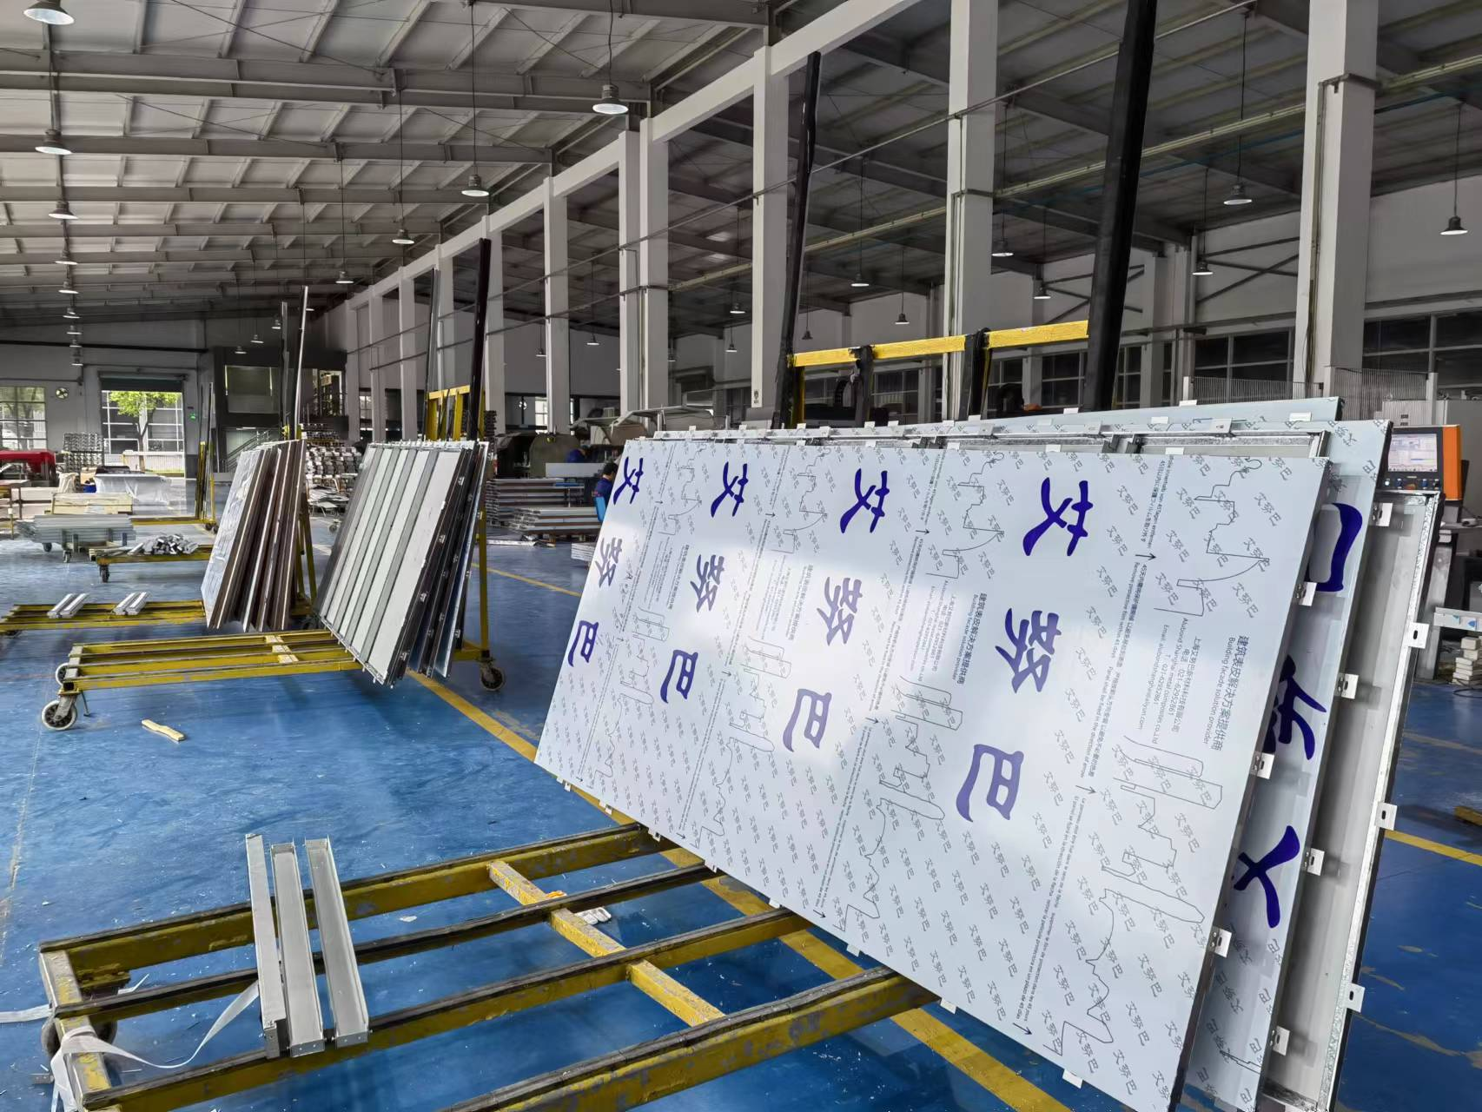
Collect the grooved sheets pass to folding and bending process
After folding and bending ,and put the bearing bar and hook put ready for package.

Slide 21
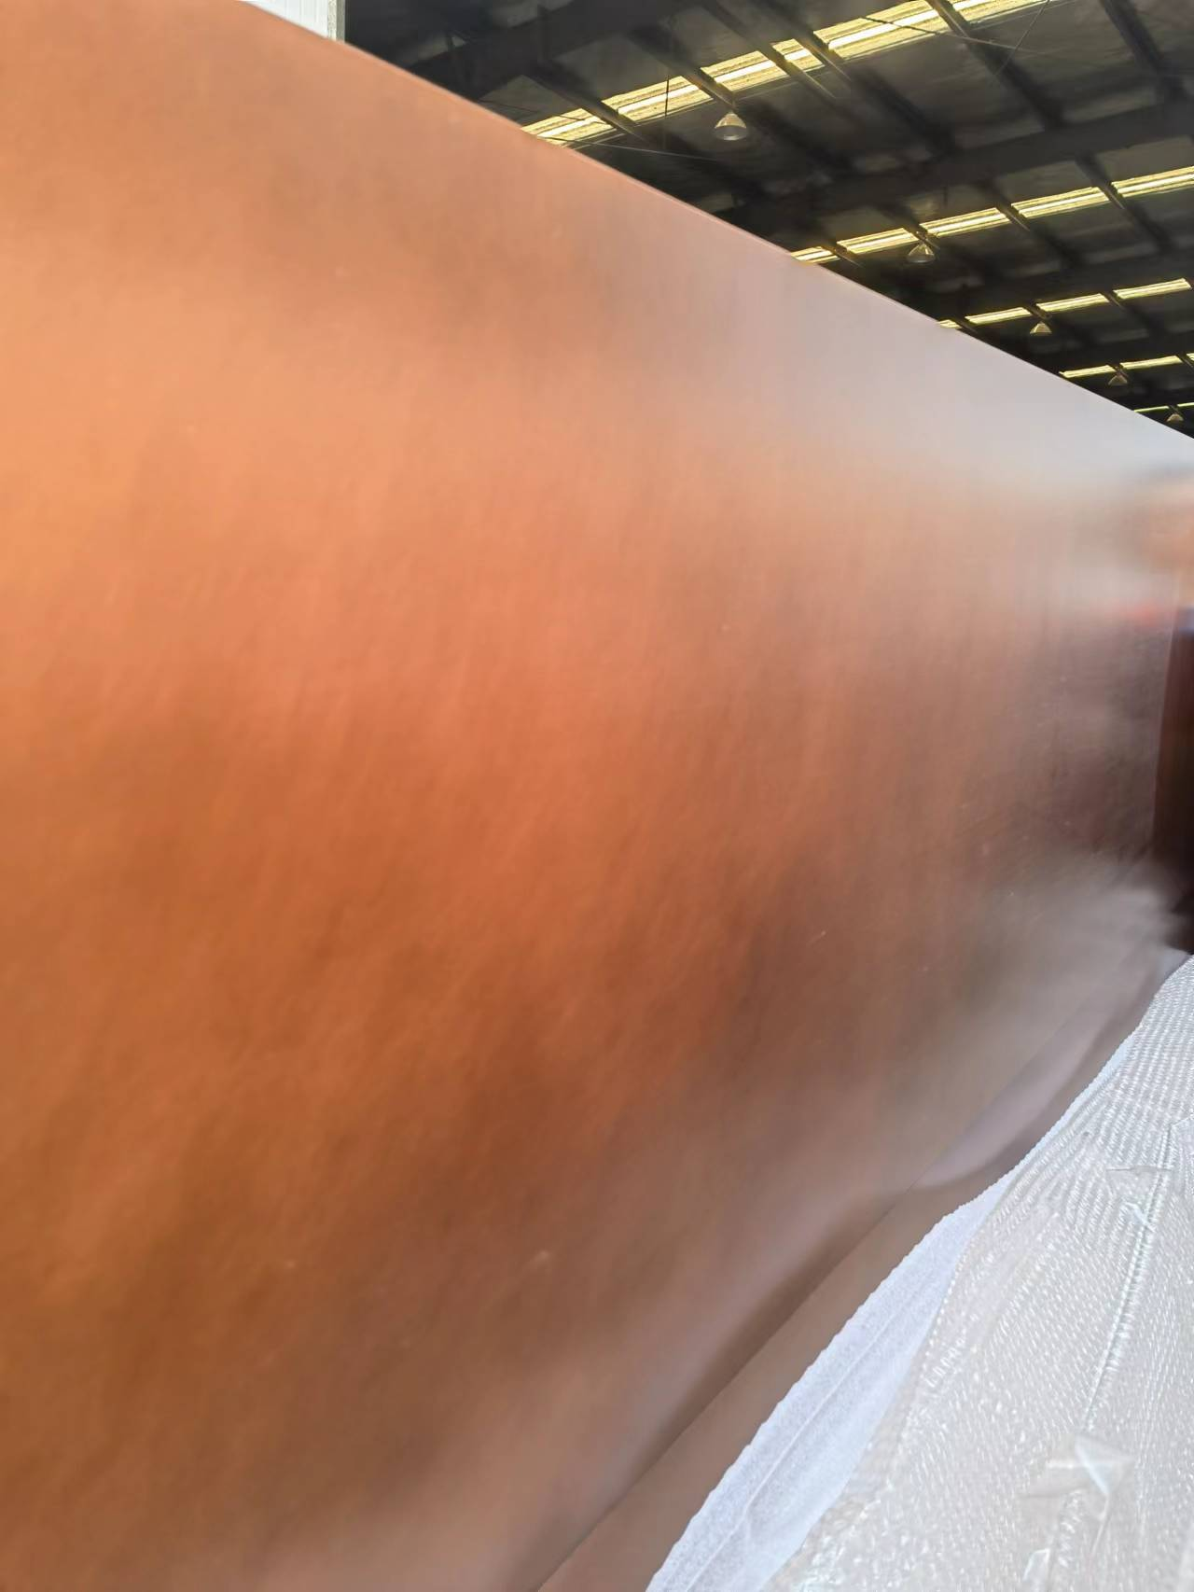
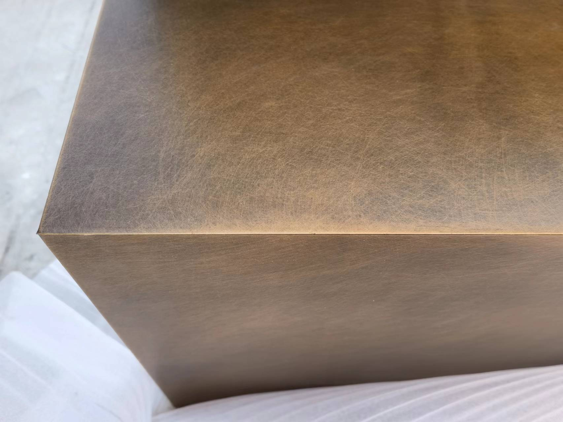
Take off the protective film to check the surface color and quality
Take off the protective film to check the surface color and quality

Slide 22
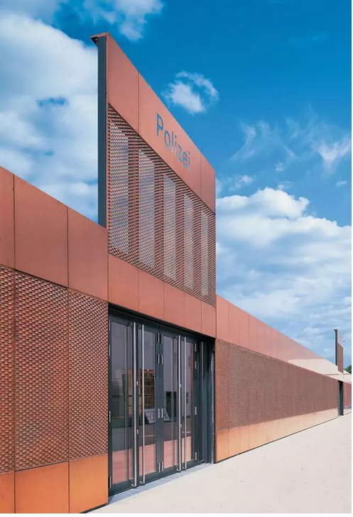
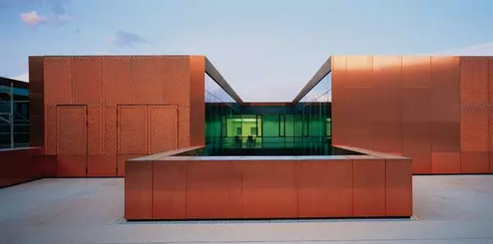
Install the sheets on building

Slide 23
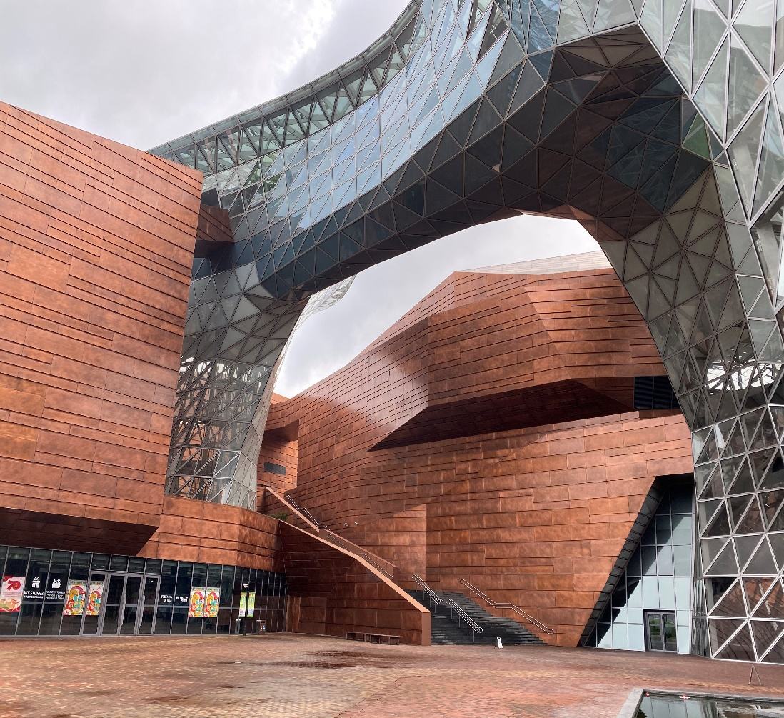
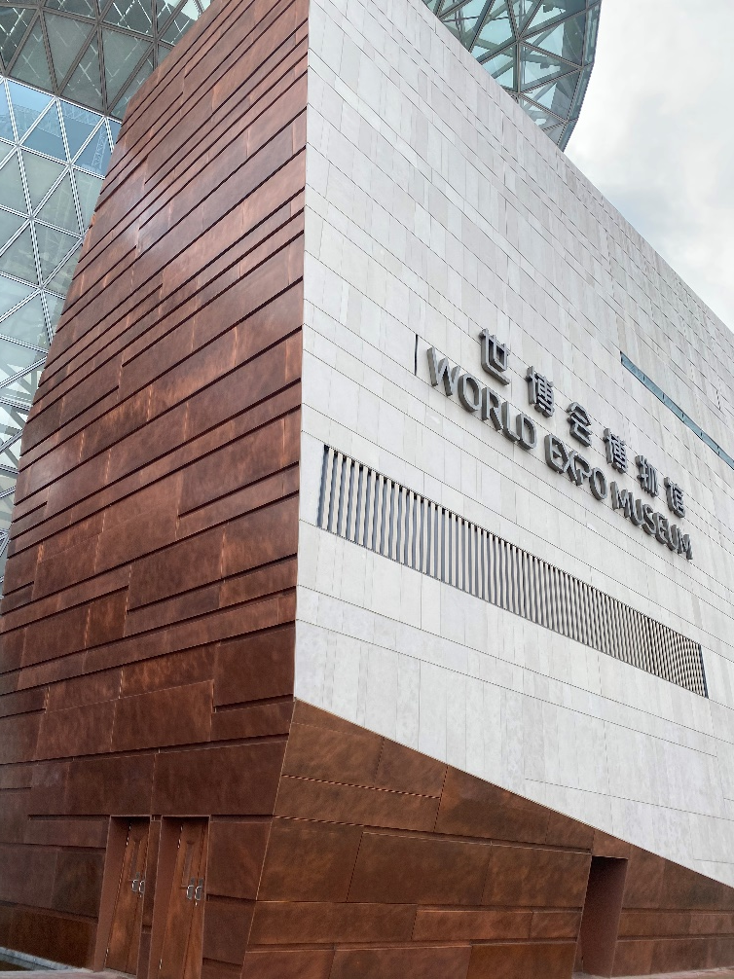
The pre- factory aging effect of copper is a chemical reaction process, and it is very difficult to maintain the consistency of appearance color. Usually, the final formed appearance has a certain color difference。 --world expo museum. Shanghai.

Slide 24
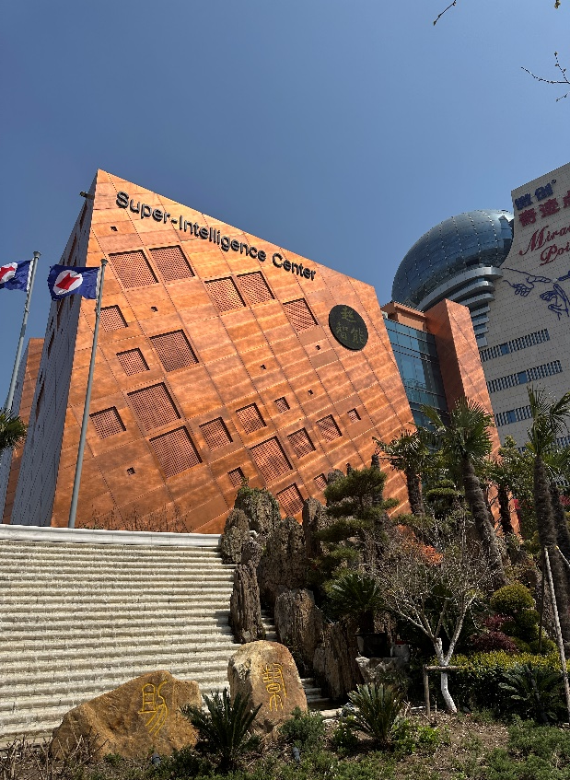
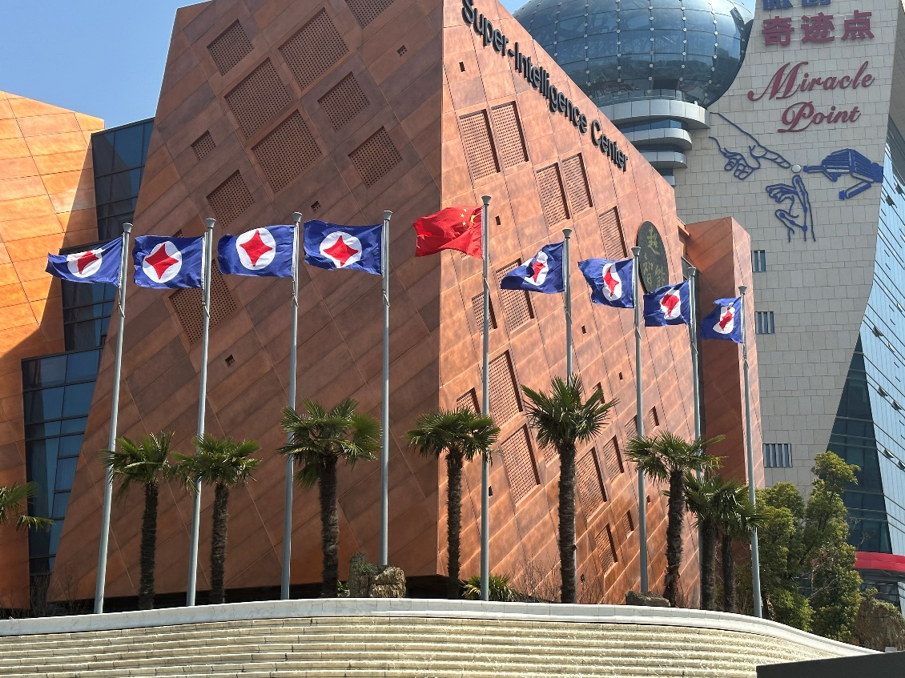
The pre-factory aging effect of copper is a chemical reaction process, and it is very difficult to maintain the consistency of appearance color. Usually, the final formed appearance has a certain color difference。 --Super Intelligence Center, Shanghai

Slide 25
Stainless steel composite panel
06
characteristics：
thickness：4mm
FR class：FR A2
top skin：0.3mm stainless steel
core：mineral
bottom skin：coated 0.5mm AL skin
specification：(limited by SS coil width)
Standard size：1200mm*3200mm
Max size：1200mm*7000mm
Substrate: brush coil, sand coil, mirror 304,316 etc

Slide 26
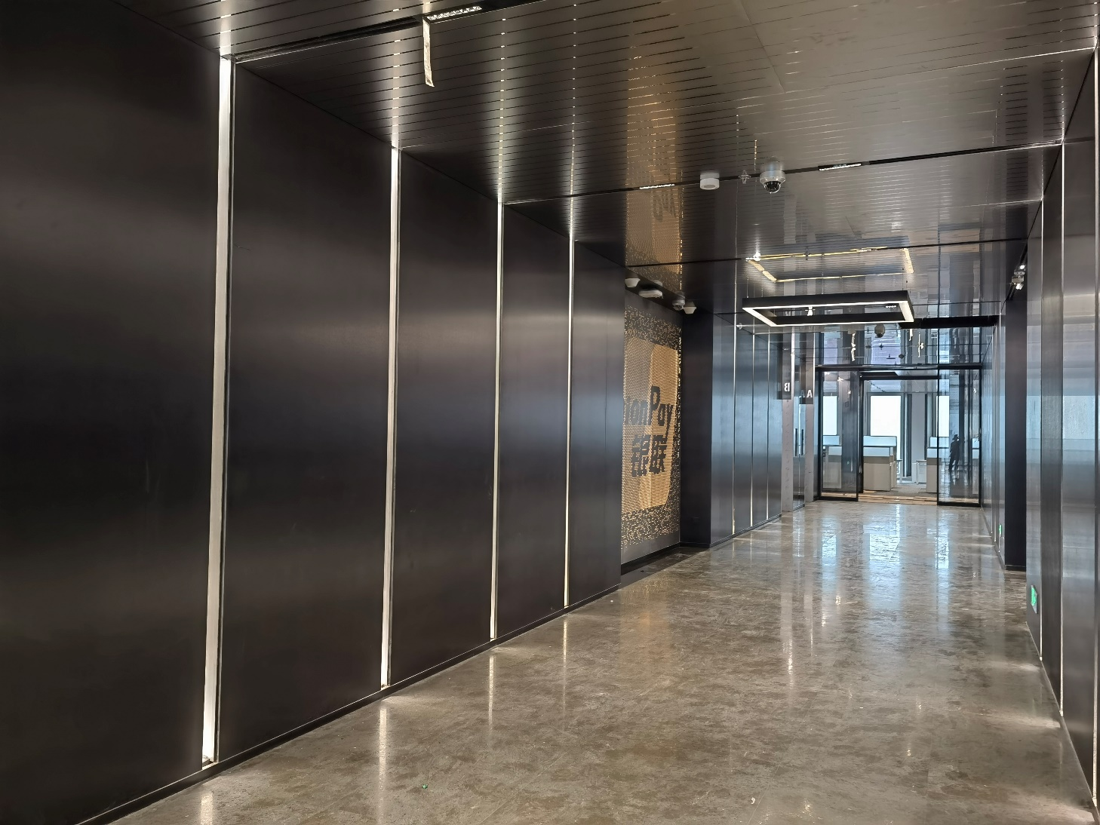
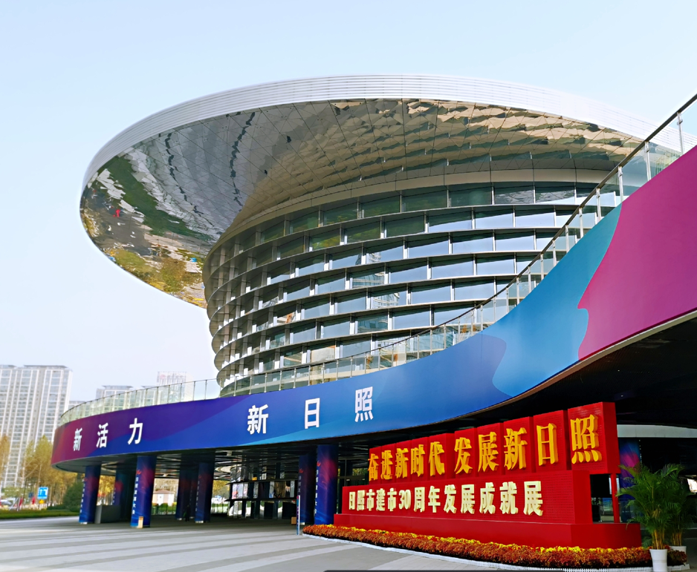
black brush stainless steel panel for Union Pay
Mirror for Rizhao international center

Slide 27
Al coil coating composite panel-general
07
characteristics：
thickness：4mm
FR class：FR A2
top skin：0.5mm PVDF coil coating Al skin
core：mineral
bottom skin：coated 0.5mm AL skin
specification：(general coating, such as solid color, metallic color, prismatic color etc)
Standard size：1250mm*3200mm
Max size：2000mm*8000mm
Substrate: 3003 ,5005 etc alloy

Slide 28
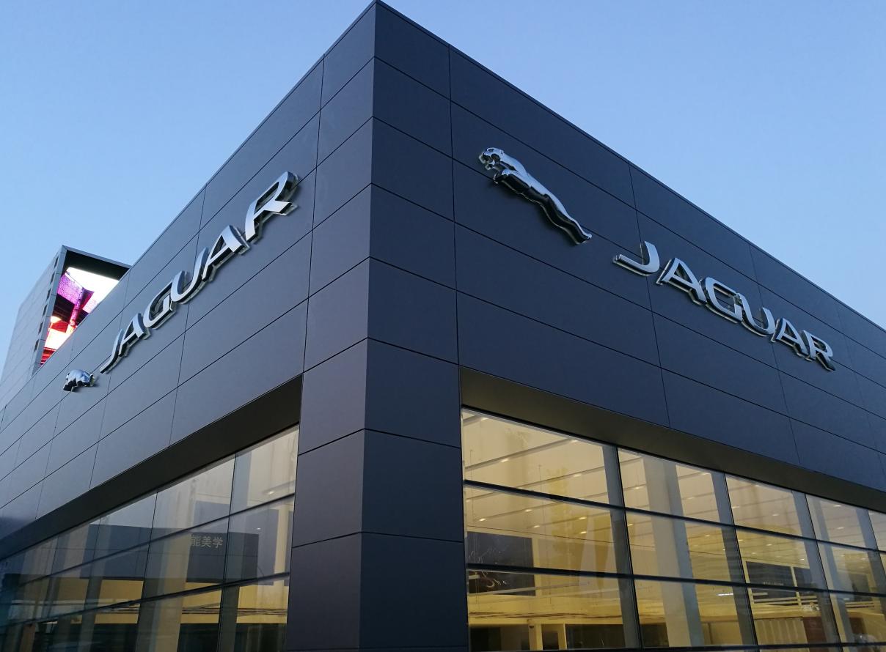
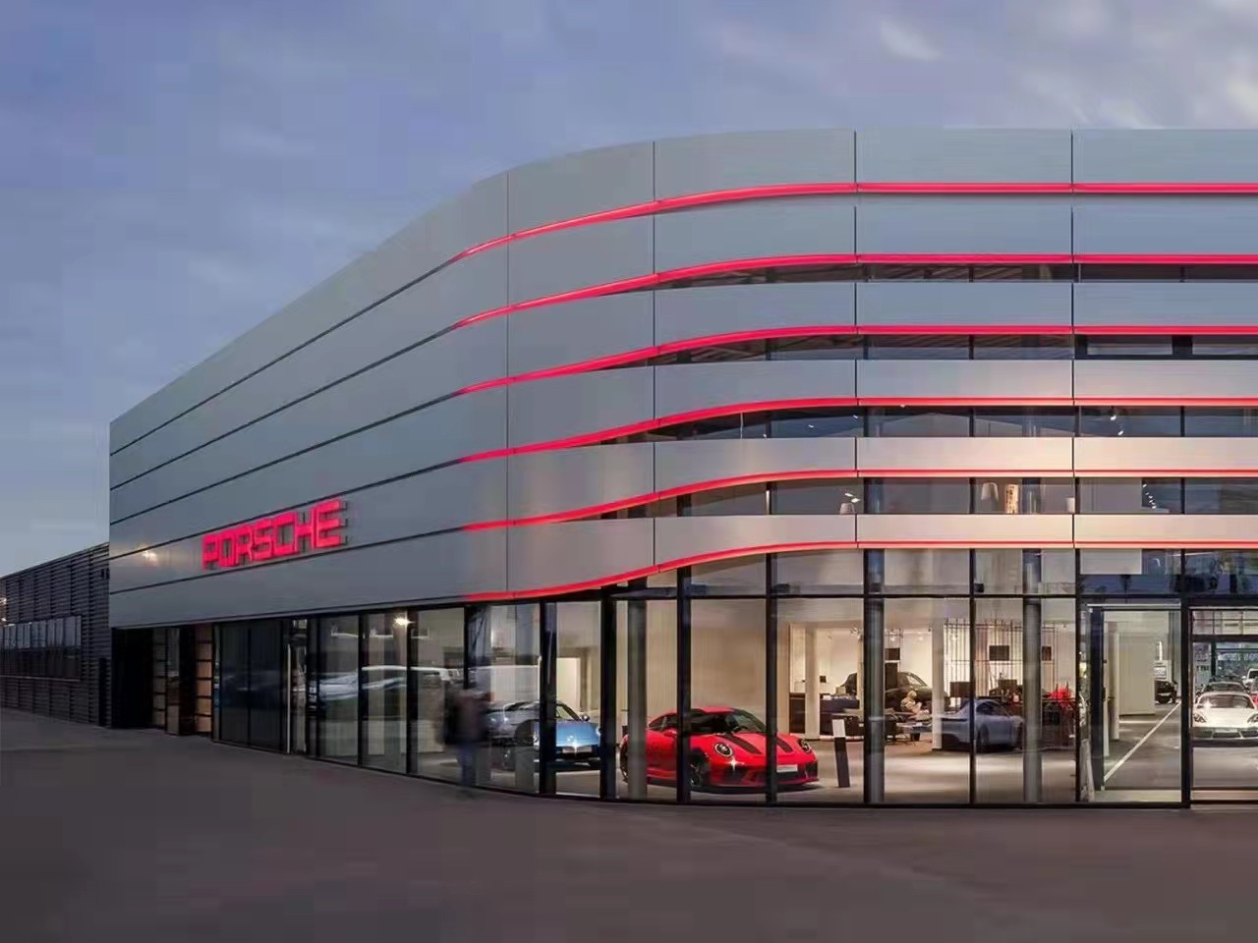
GRAY PVDF coating for JAGUAR
SILVER PVDF coating for PROSCHE

Slide 29
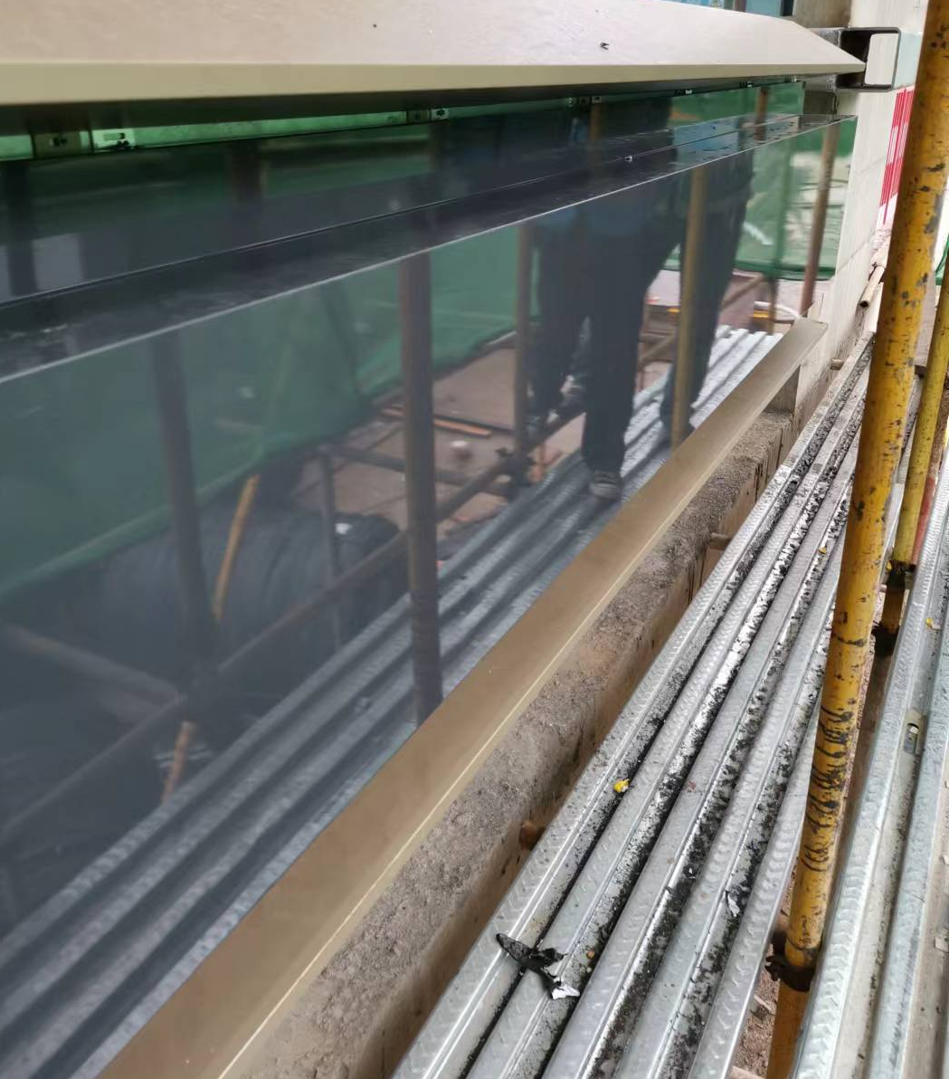
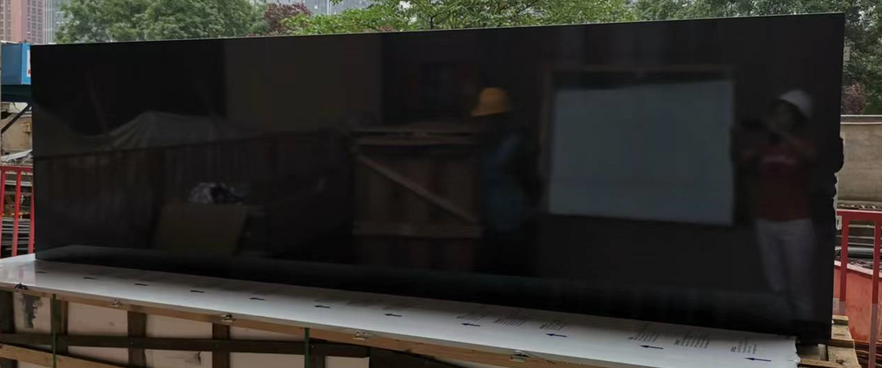
high gloss glass appearance metal panel fix on wall
Glass appearance metal panel

Slide 30
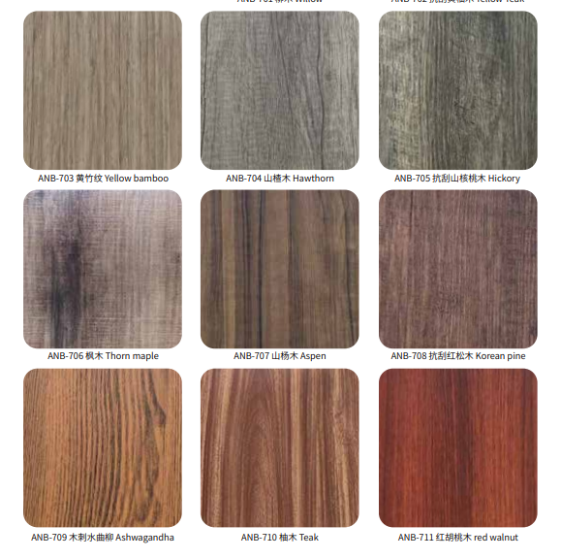
Al coil coating composite panel-artificial
08
characteristics：
thickness：4mm
FR class：FR A2
top skin：0.5mm PVDF coil coating Al skin
core：mineral
bottom skin：coated 0.5mm AL skin
specification：(artificial coating, such as wood, stone,cement color)
Standard size：1250mm*3200mm
Max size：1500mm*8000mm
Substrate: 3003 ,5005 etc alloy

Slide 31
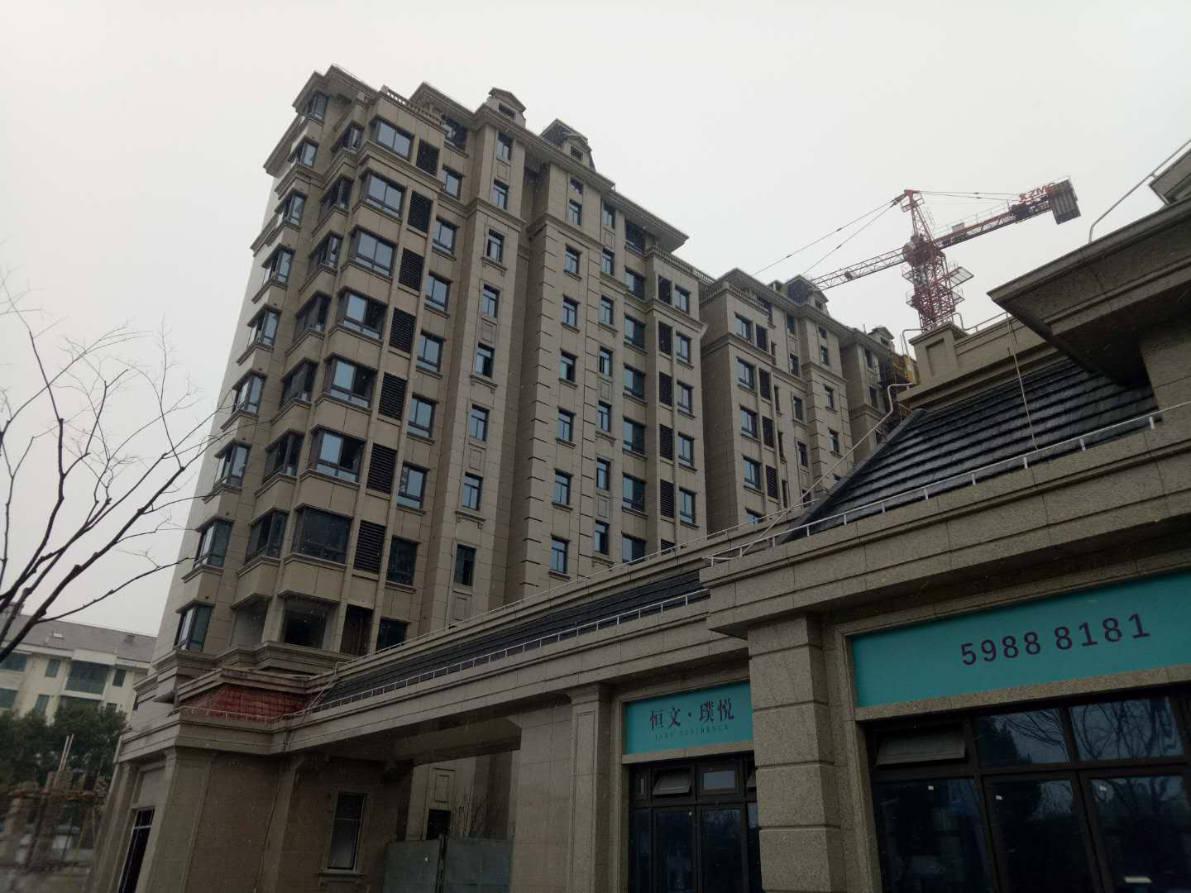
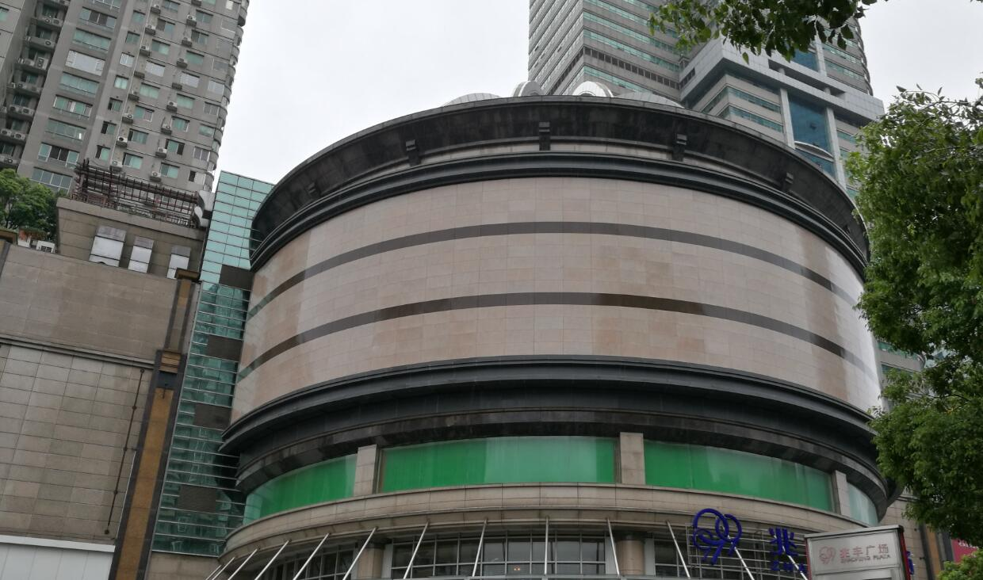
stone – low gloss
Stone-high gloss

Slide 32
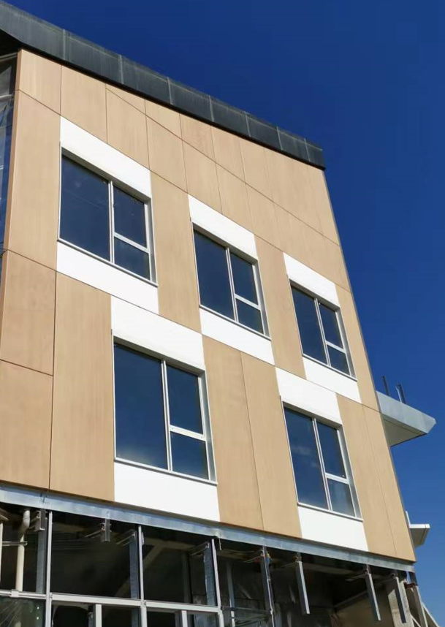
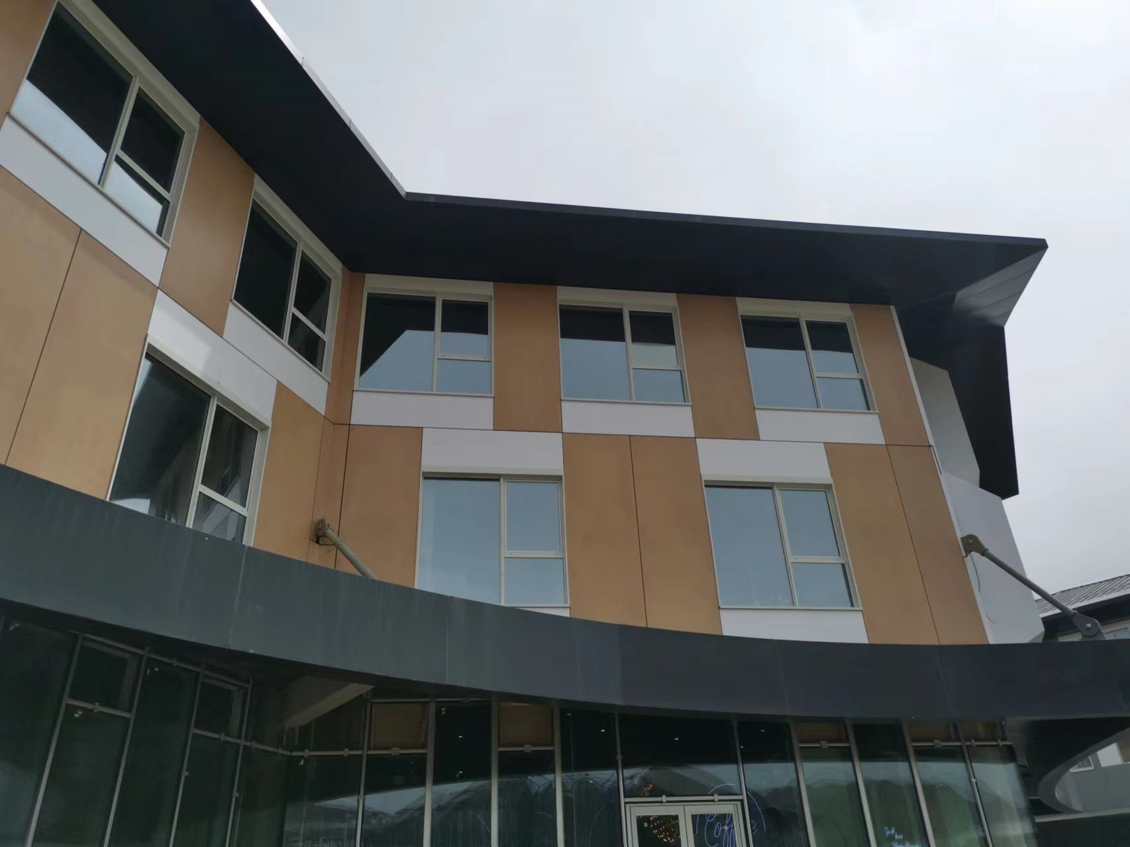
wood –low gloss with sand pattern
texture available

Slide 33
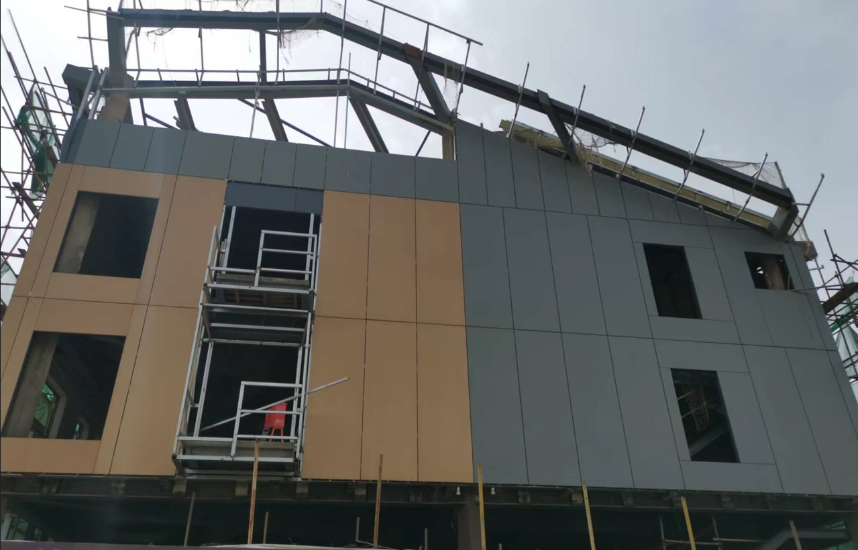
cement with texture
Texture

Slide 34
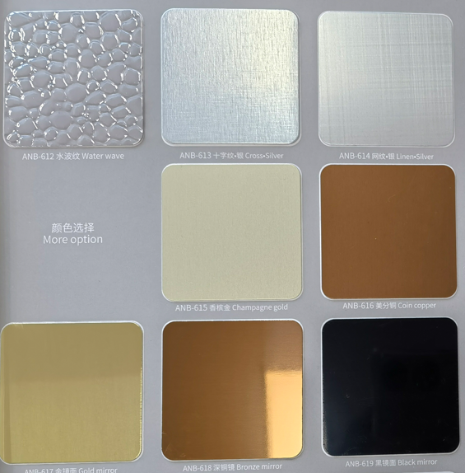
Al anodized composite panel
09
characteristics：
thickness：4mm
FR class：FR A2
top skin：0.5mm anodized Al skin
core：mineral
bottom skin：coated 0.5mm AL skin
specification：(low gloss,high gloss, brush,sand,satin,mirror etc)
Standard size：1250mm*3200mm
Max size：1500mm*8000mm
Substrate: 3003 ,5005 etc alloy

Slide 35
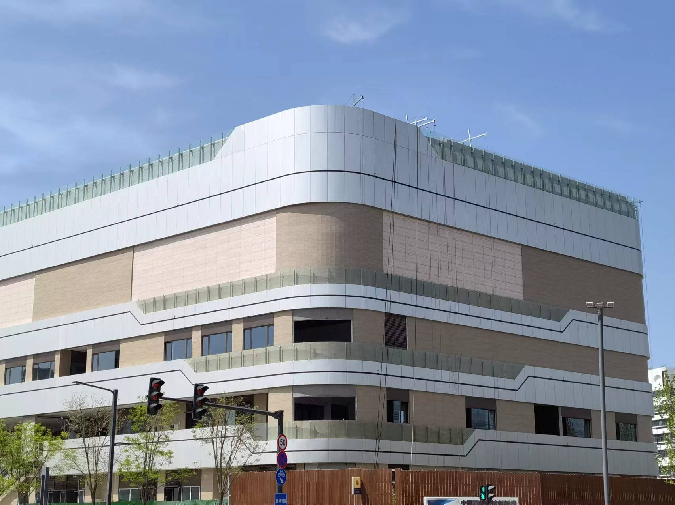
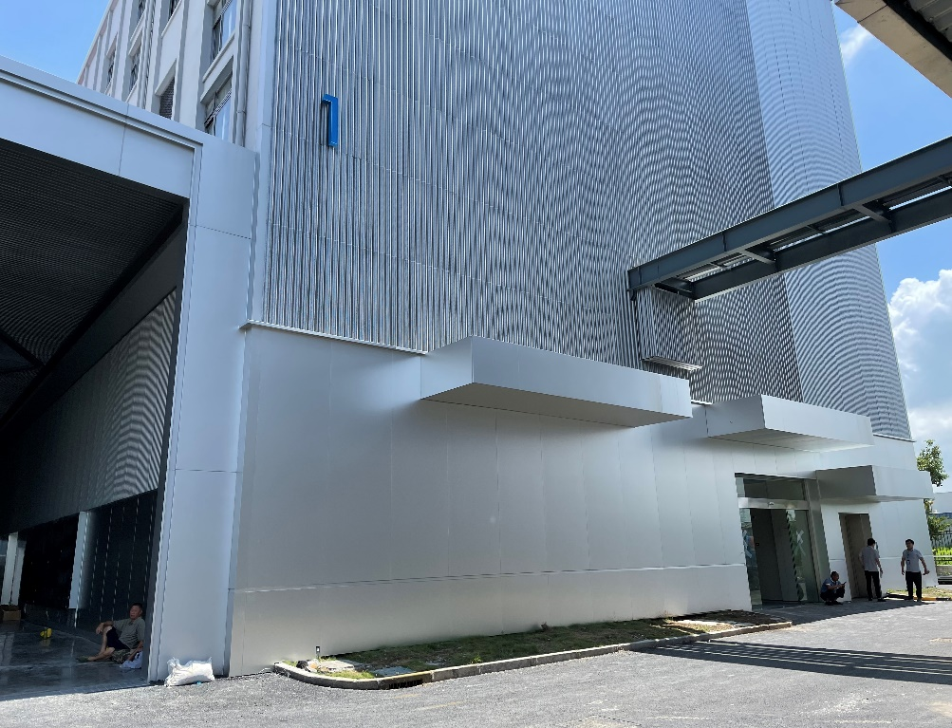
04
Anodized Al skin it is a high durability protect façade material, it is excellent performance especially under the tough environment such as close to sea, industrial area. The surface is harder than coating by reach a 9H pencil hardness. Also it is easy to clean due to the protection lay. Many color and type of gloss is available, please contact for color chart

Slide 36
Please contact us at uetmoose@yahoo.com
Or harry.wu.
标题文字添加

