Slide 1
SUBLIMATION PROCESS
By: Angeline Liñgad Quiazon
DESIGN
PRINT
HEAT PRESS
PRINTED PRODUCT
USE SUITABLE
GRAPHIC
SOFTWARE
Use Wasatch SoftRIP
To RIP to your inkjet
printer.
SUBLIMATION
PAPER
SUBLIMATION
INKS
SUBLIMATION
PRINTER
RECOMMENDED
WORKING
TEMPERATURE
RANGE
200° C – 250° C
35-40 SECONDS
HEAT RESISTANT
TAPE
JIGS
POLYESTER
BLANKS
SOCKS

Slide 2
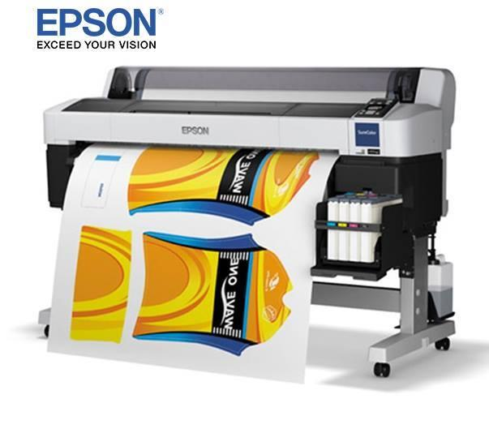
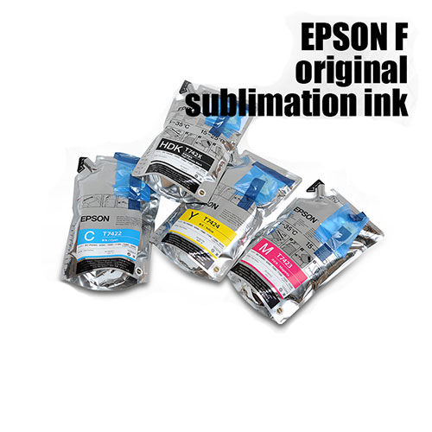
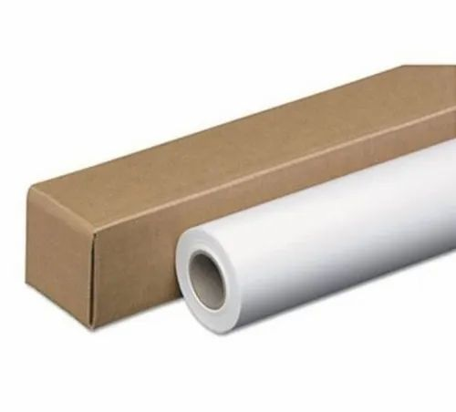
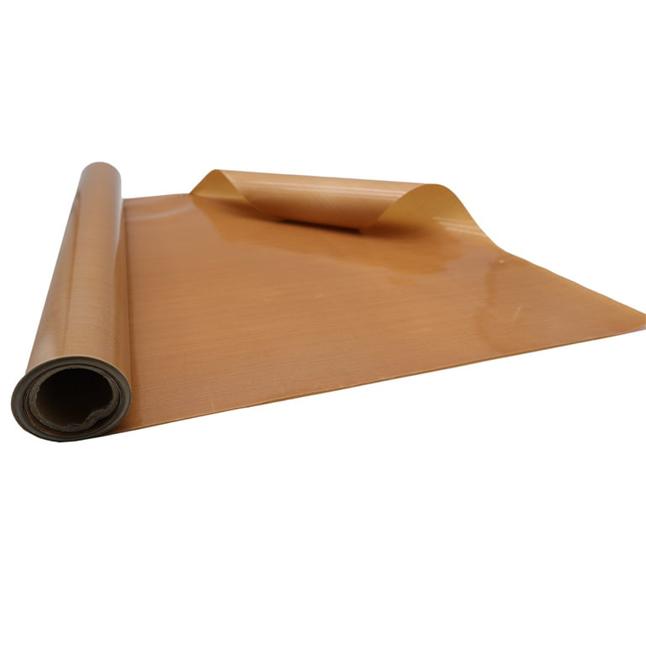
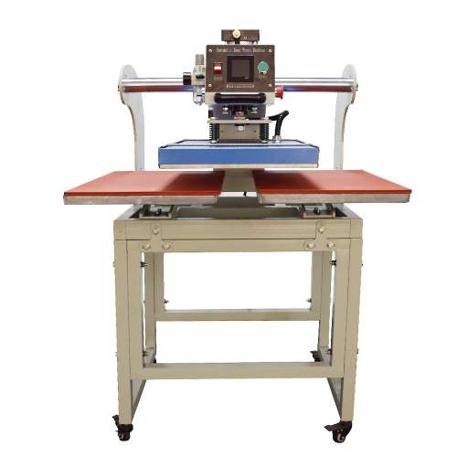
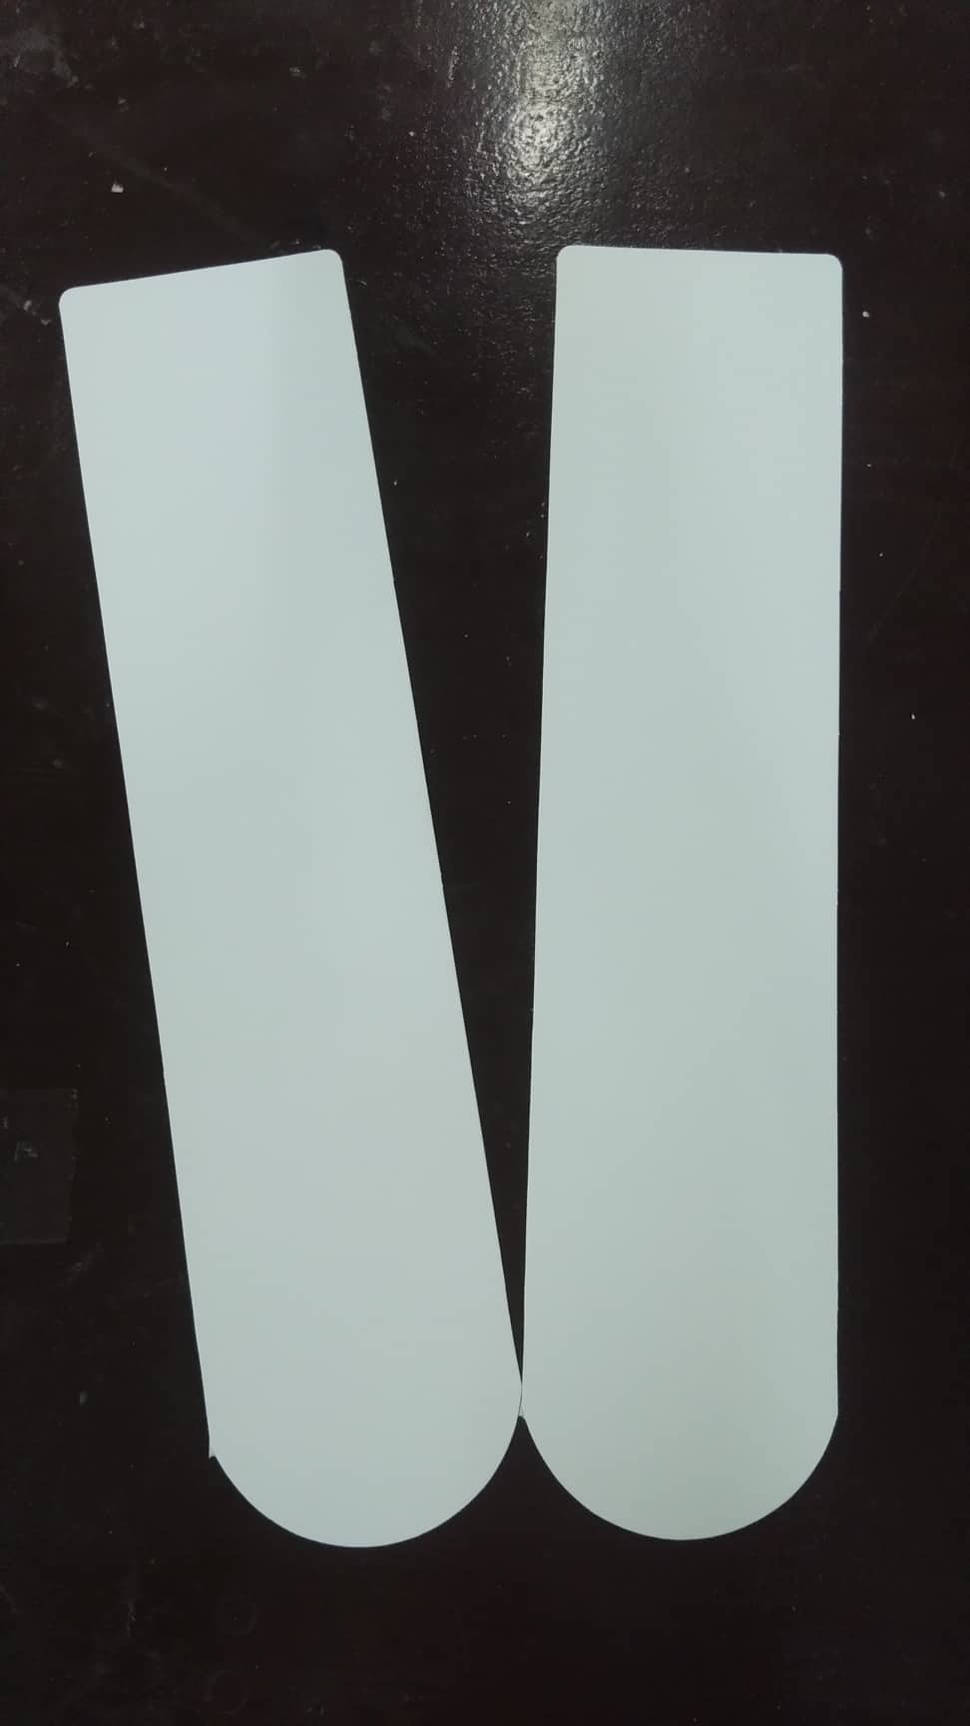
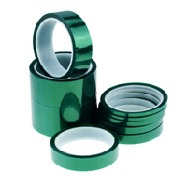
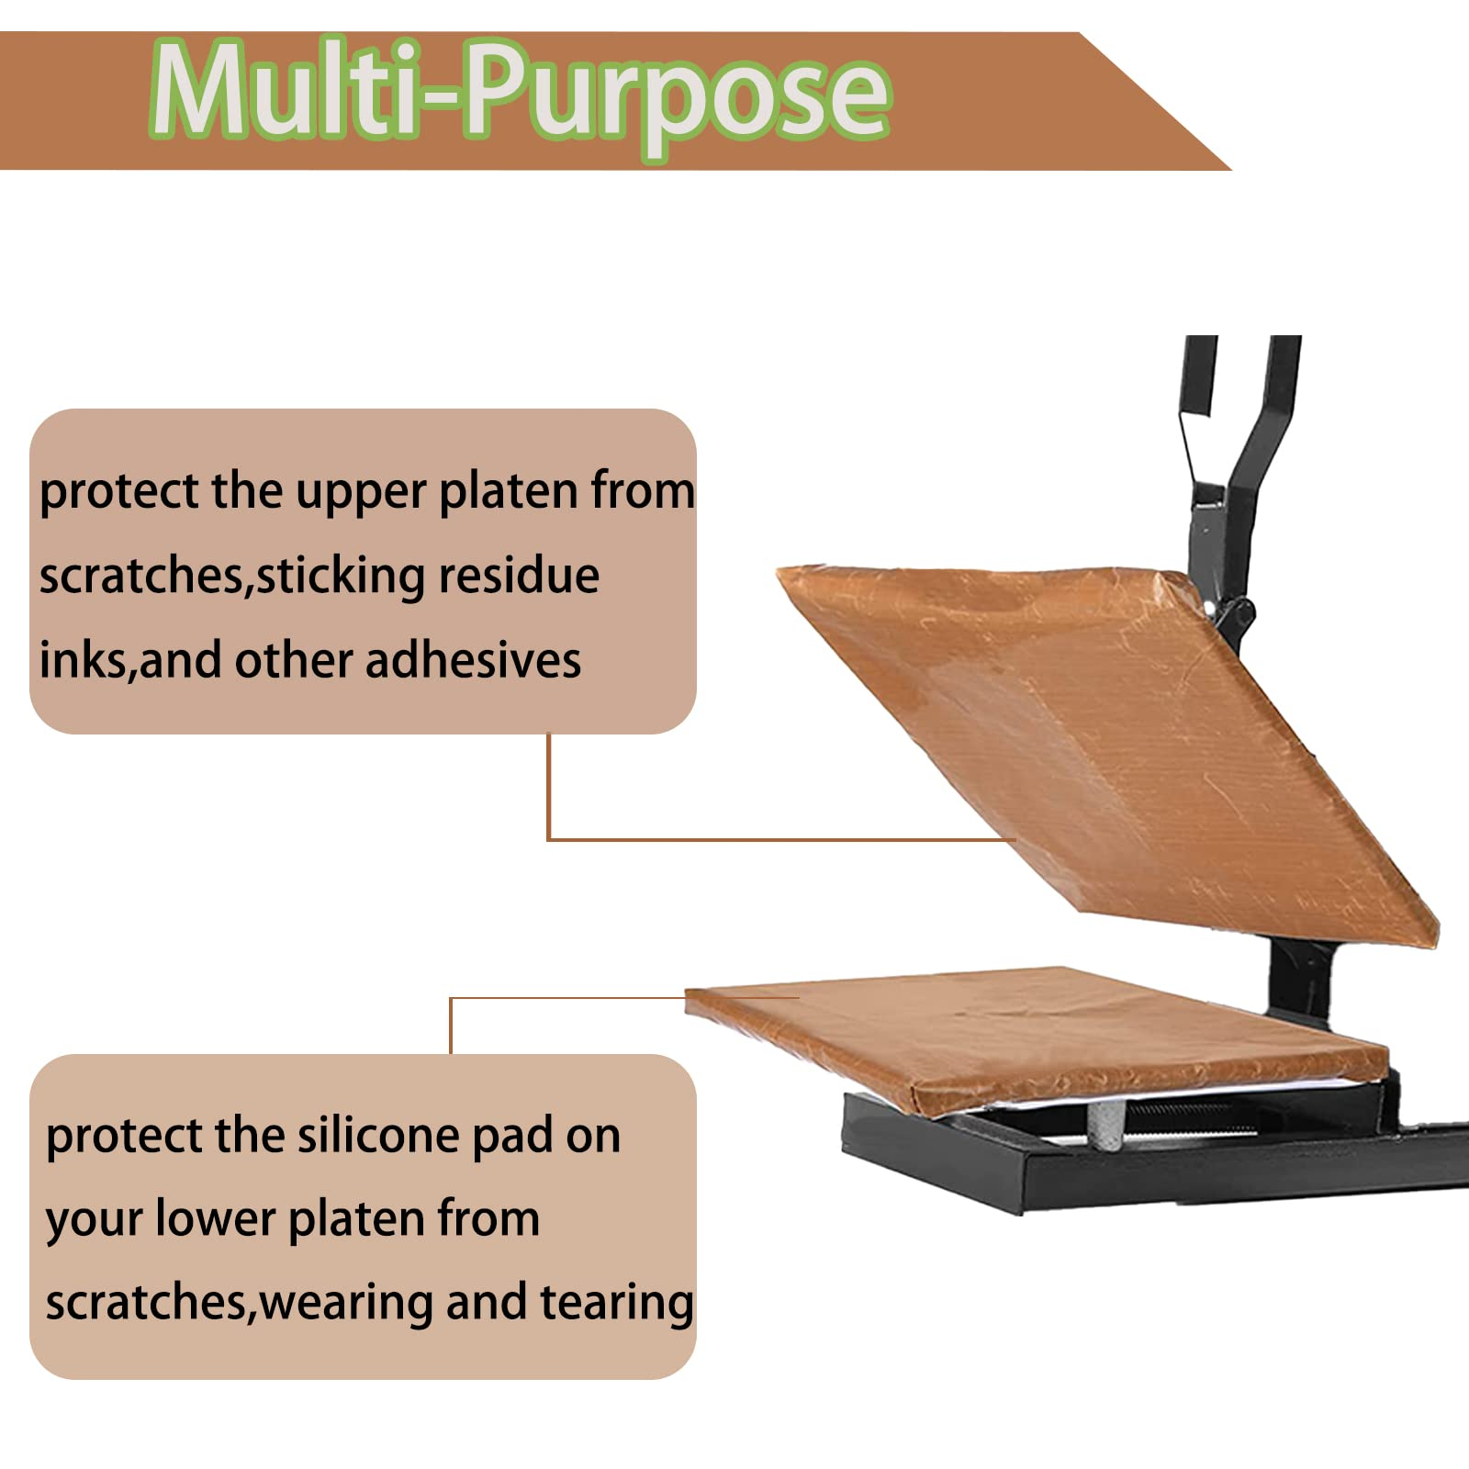
SUBLIMATION PRINTER
SUBLIMATION PAPER
TEFLON
JIGS/CARTON JIGS/INSERTS
HEAT PRESS MACHINE
HEAT RESISTANT TAPE

Slide 3
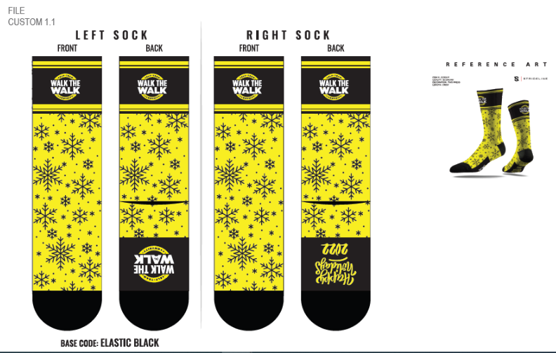
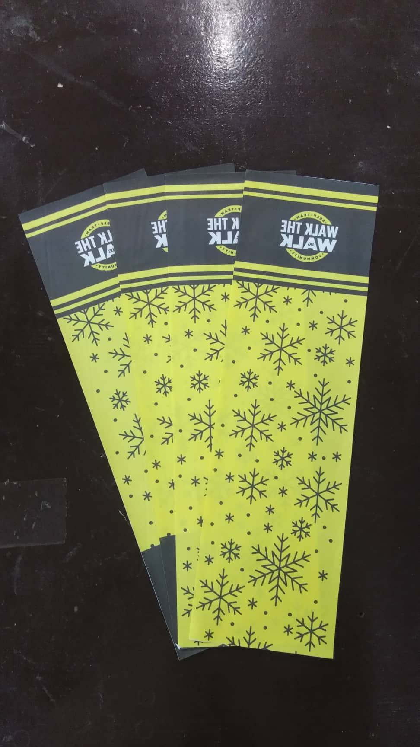
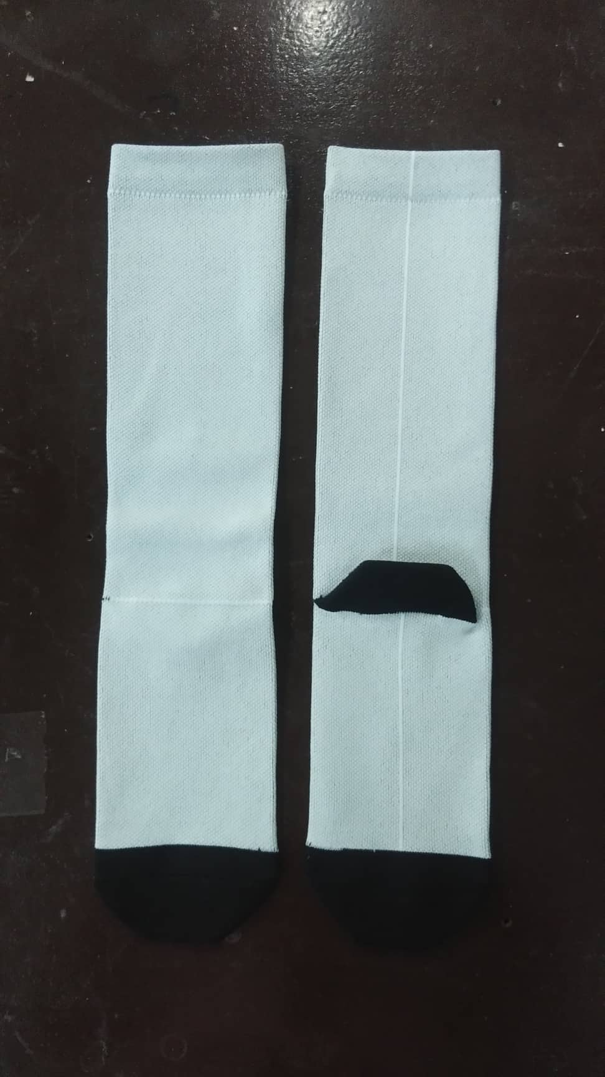
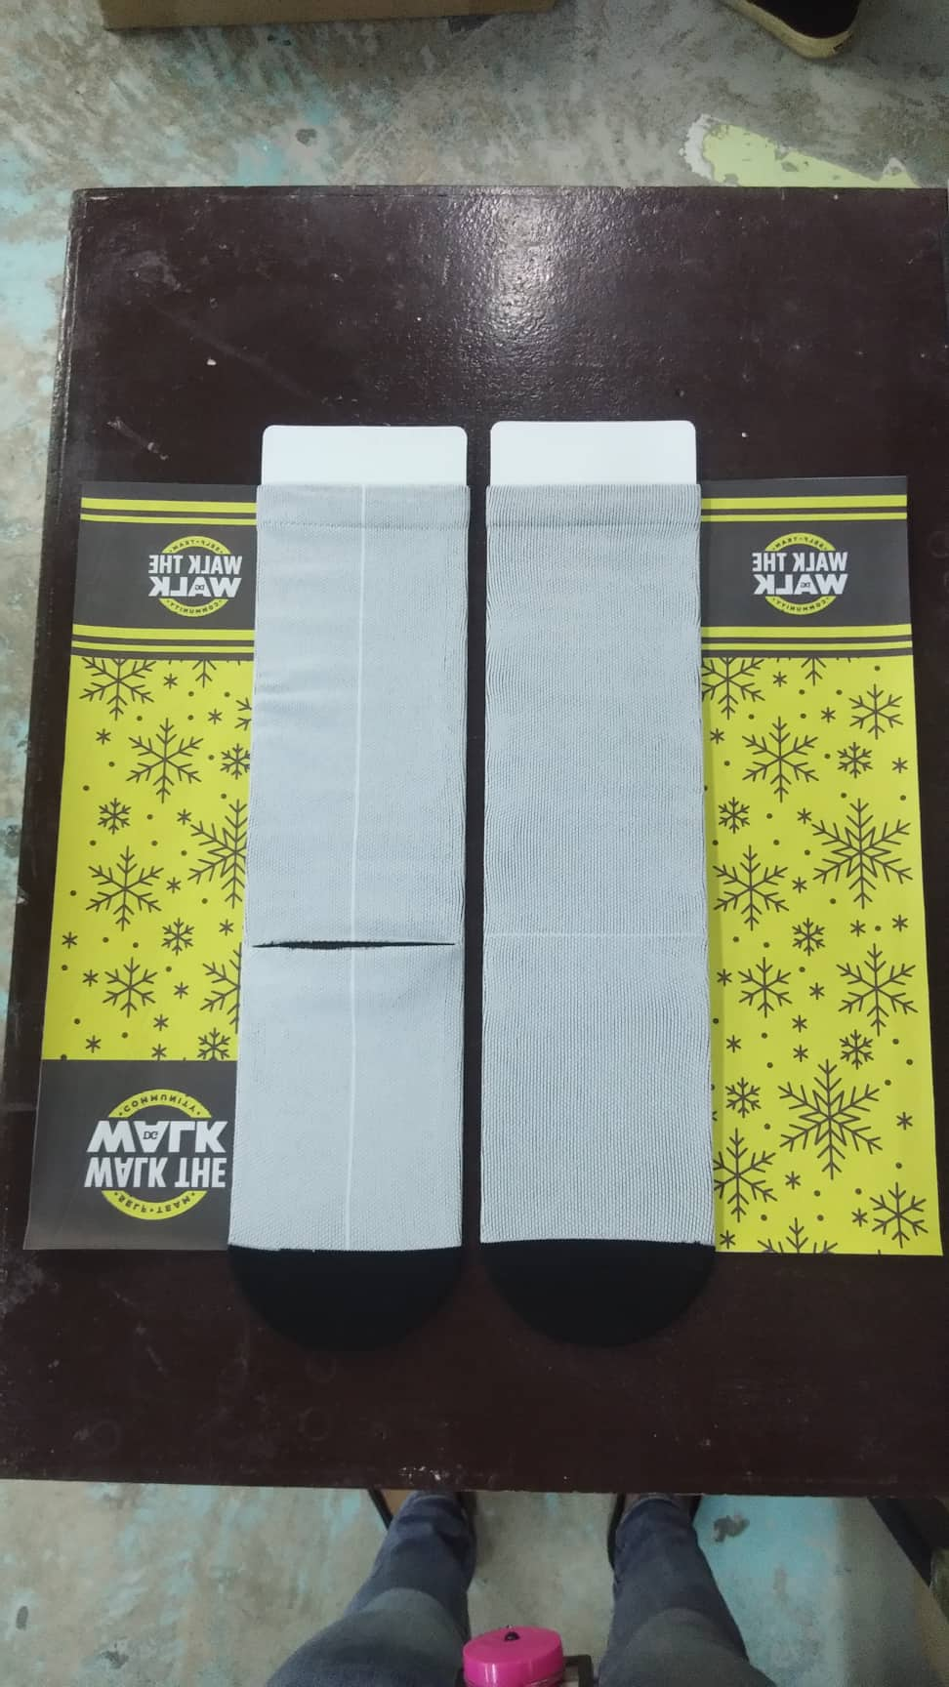
3-CREW SOCKS
Sock jigs will help ensure your socks are slightly stretched while sublimating.
This will also help the channels and ensure the socks remains flat.
They will also help when trying to get the edge of the sock.
STICKER CUT OUT
CARDBOARD JIGS
BLANKS

Slide 4
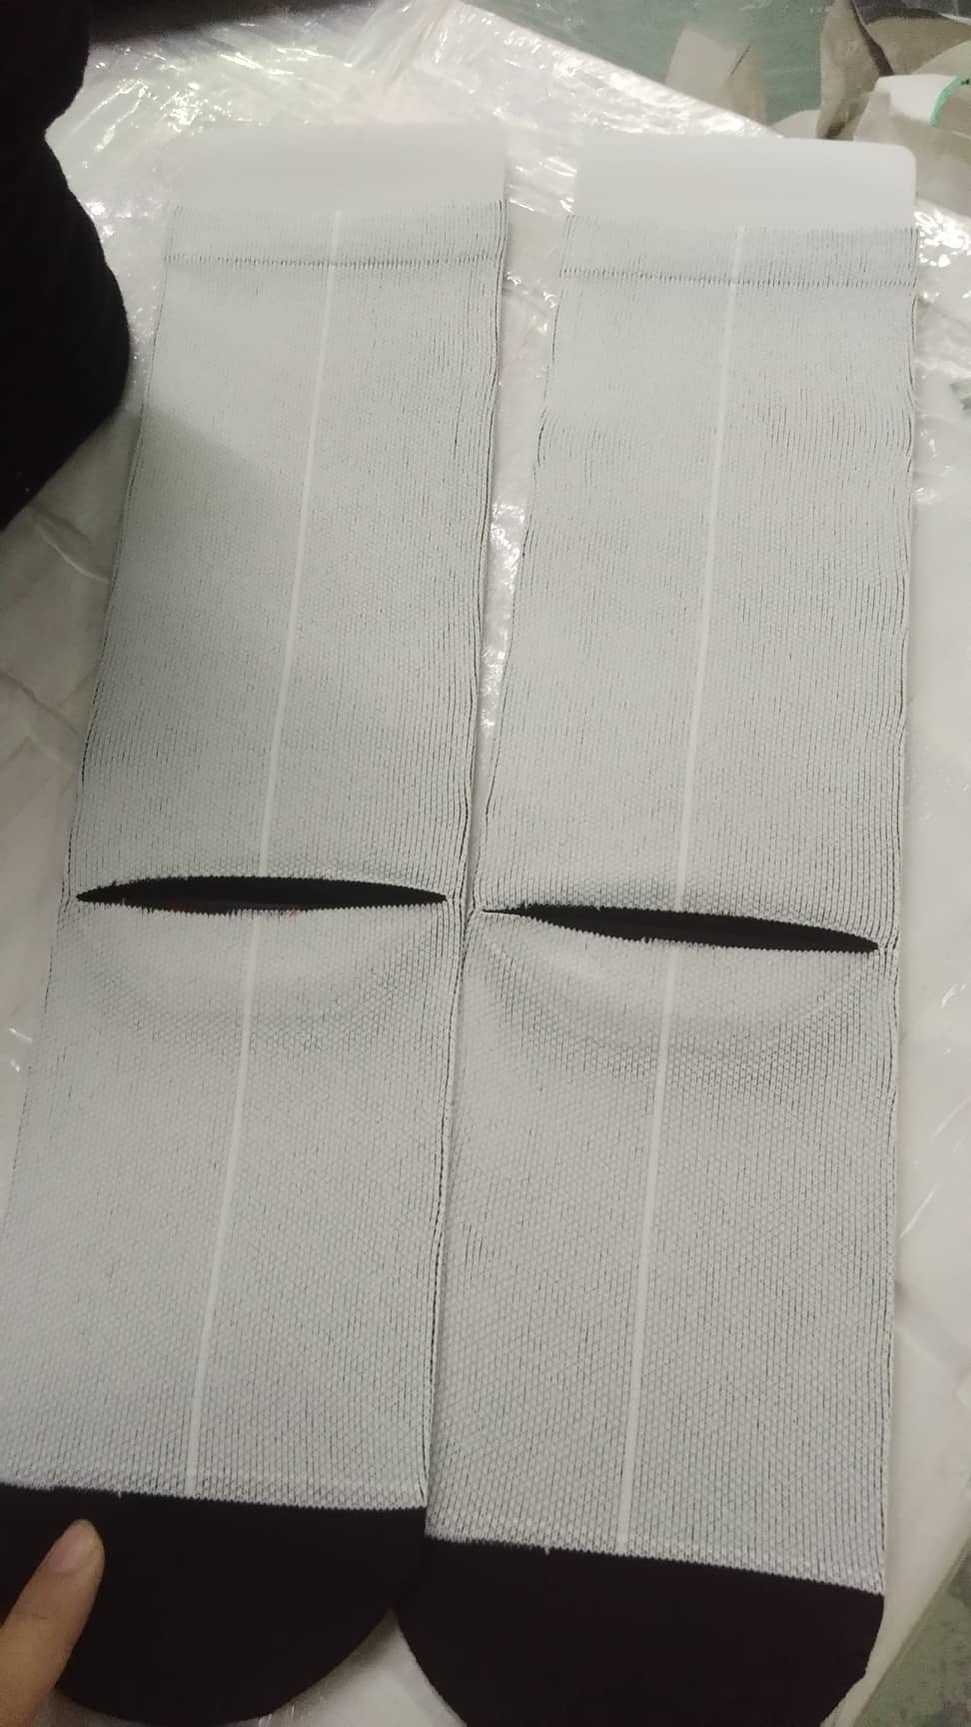
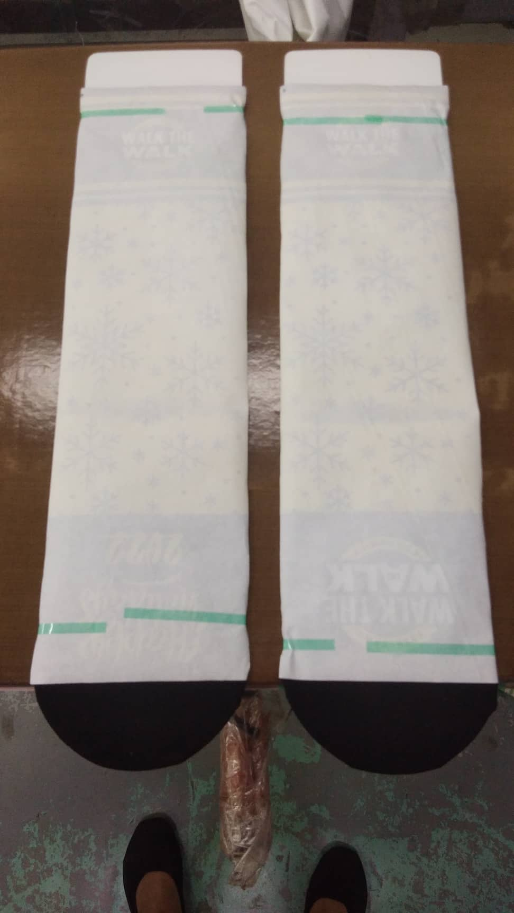
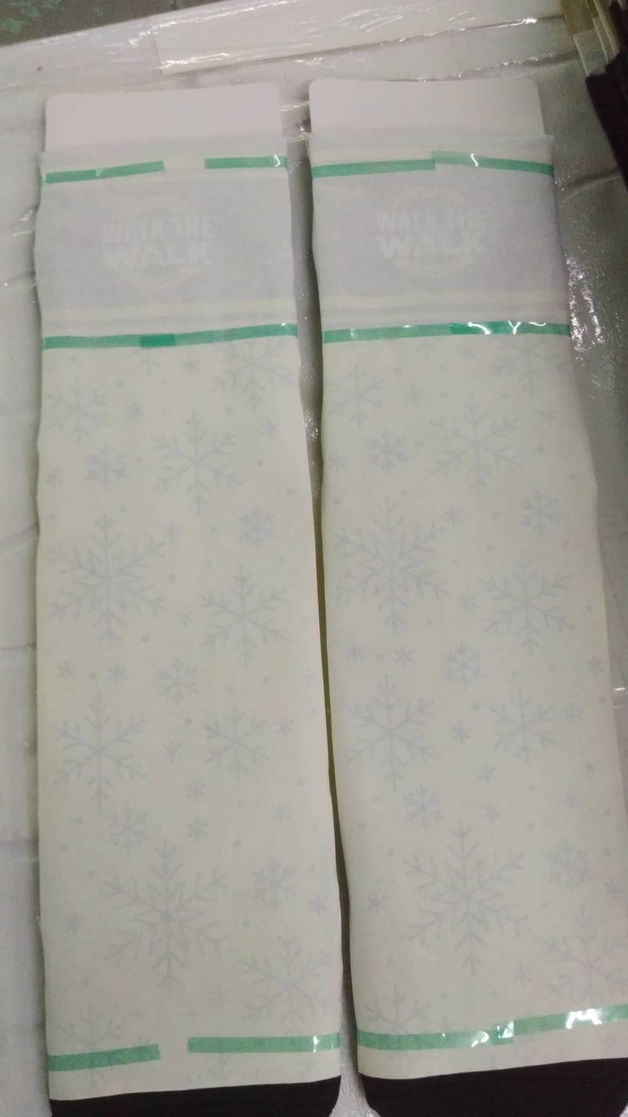
Once the blanks is already in the jig
We pre-heating it
for about 2 to 3 sec
To avoid the fading part on the foot part
1st taping
We are starting from the back
After the 1st taping pressing then after it has been pressed
We need to switch, flip and roll
Before we proceed in the 2nd taping
We flip it in front a little so that it will not have a white line
We will line up the 2nd sticker, make sure that it will match with the 1st taping.
See the video below:

Slide 5
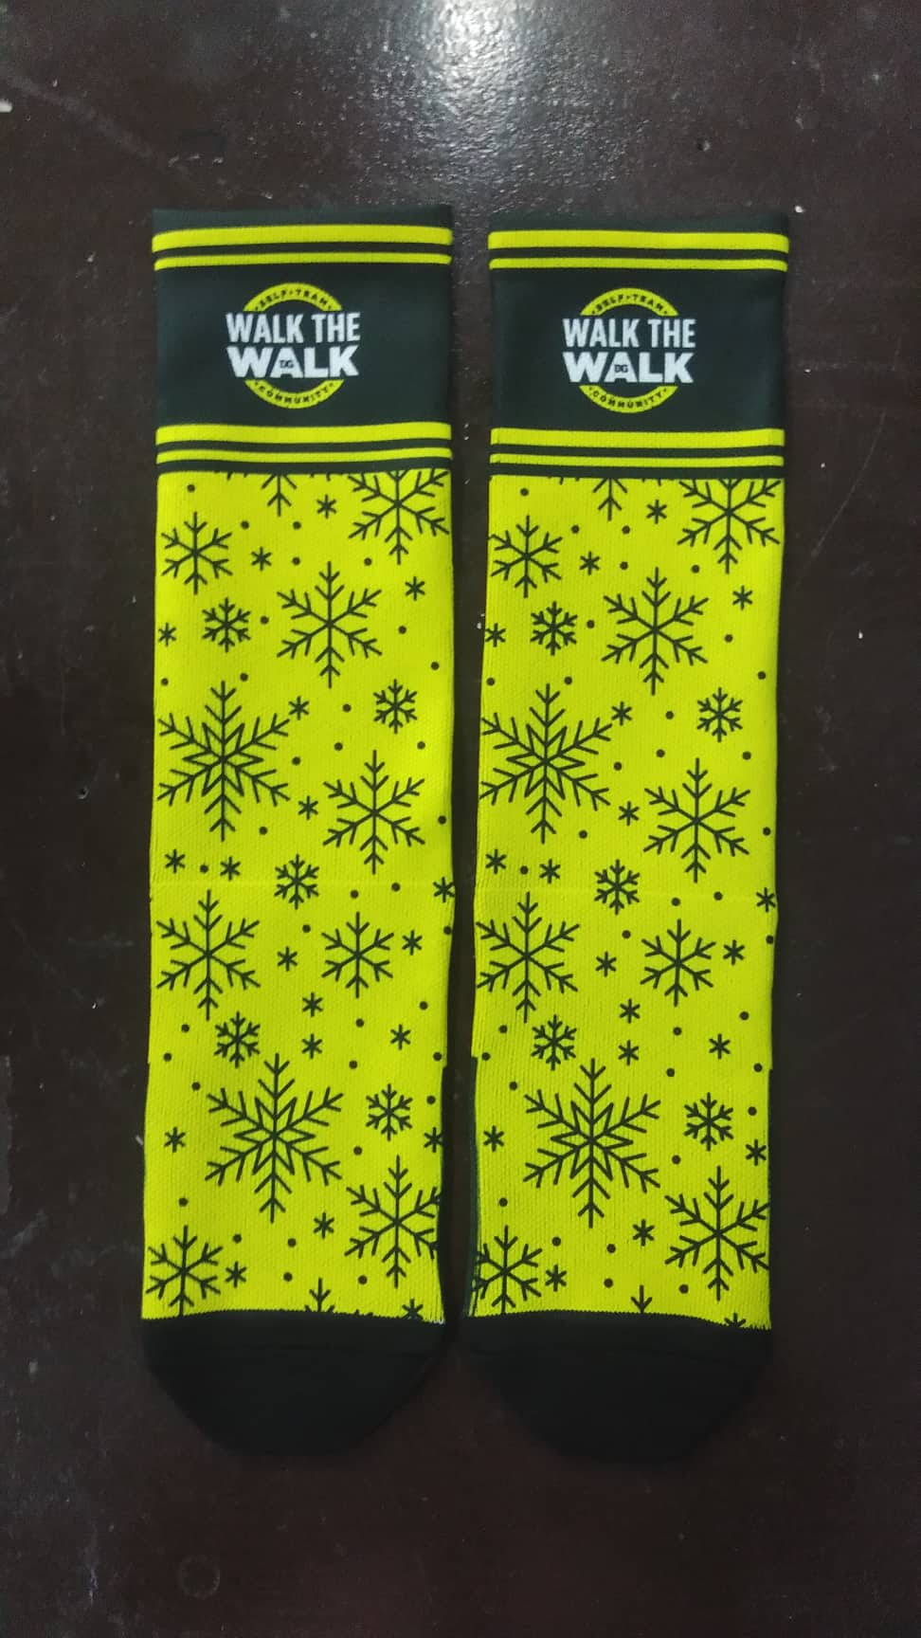
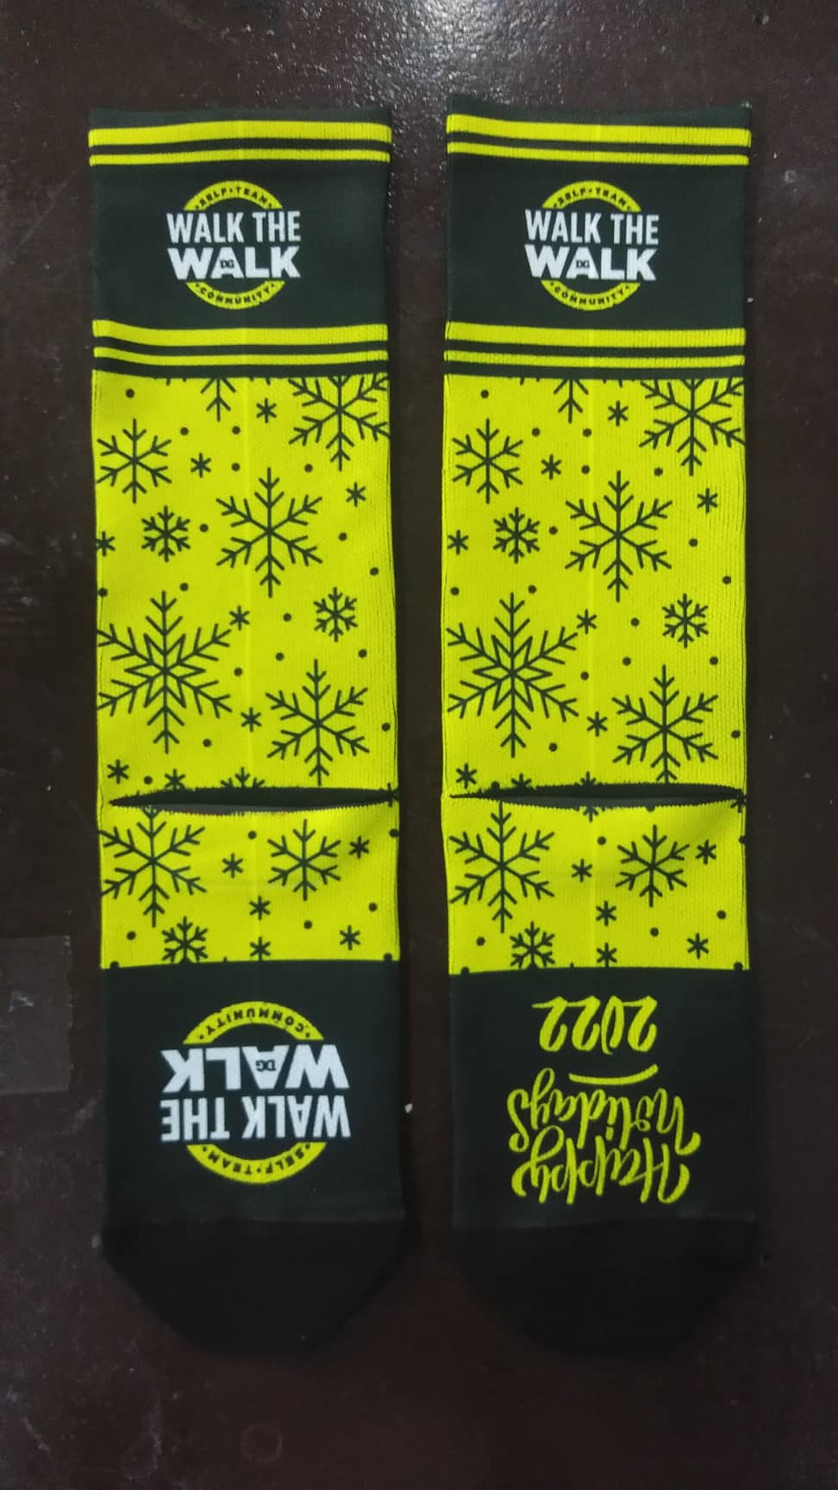
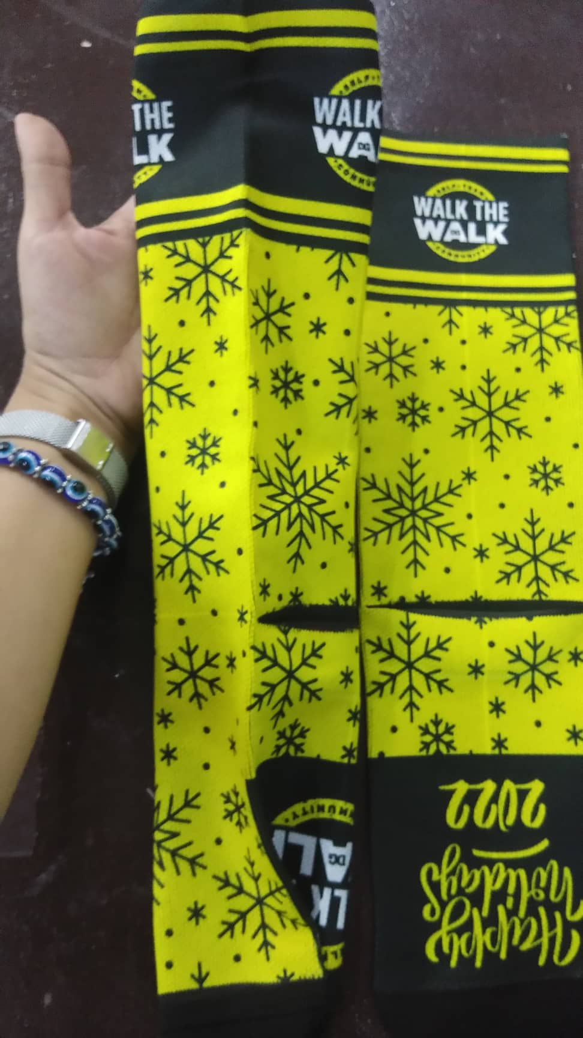
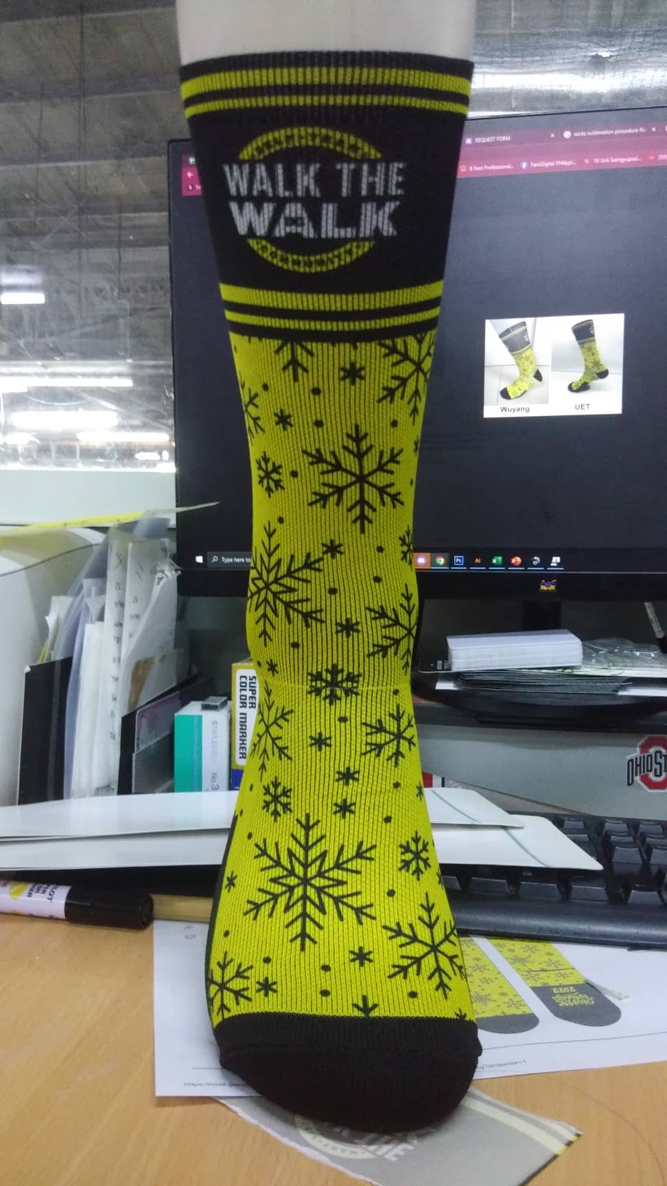
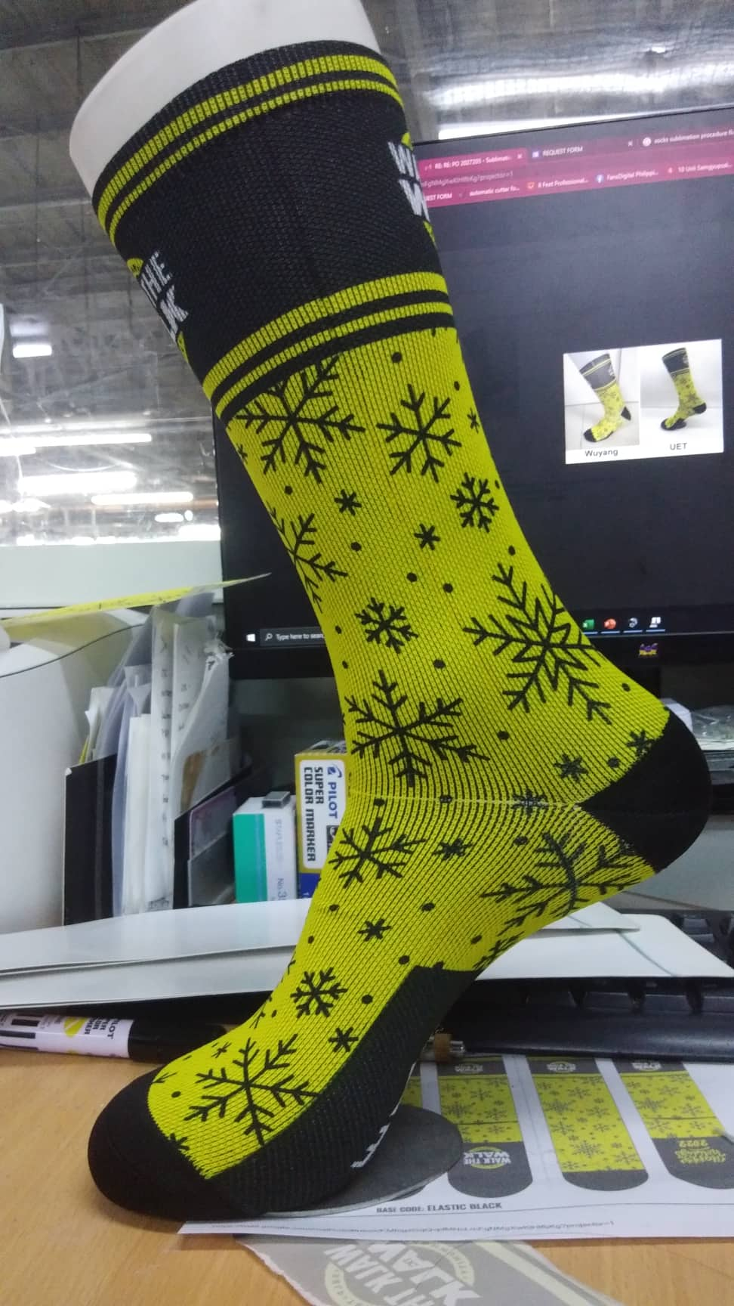
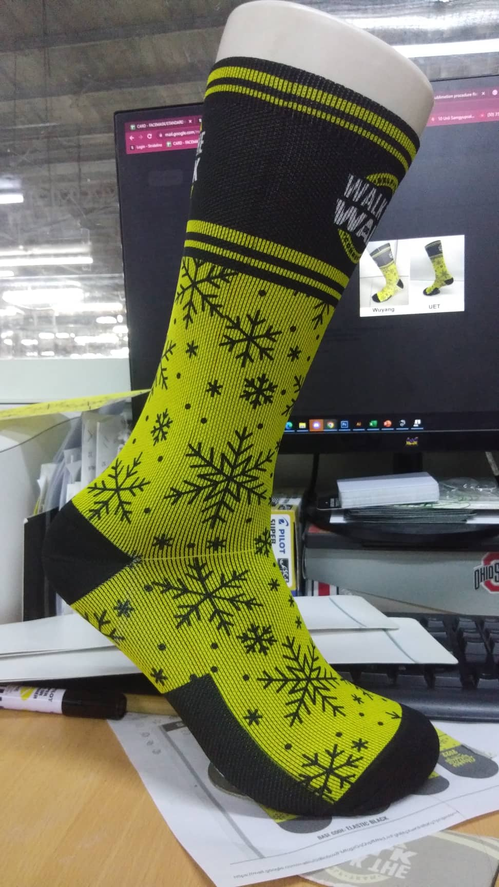
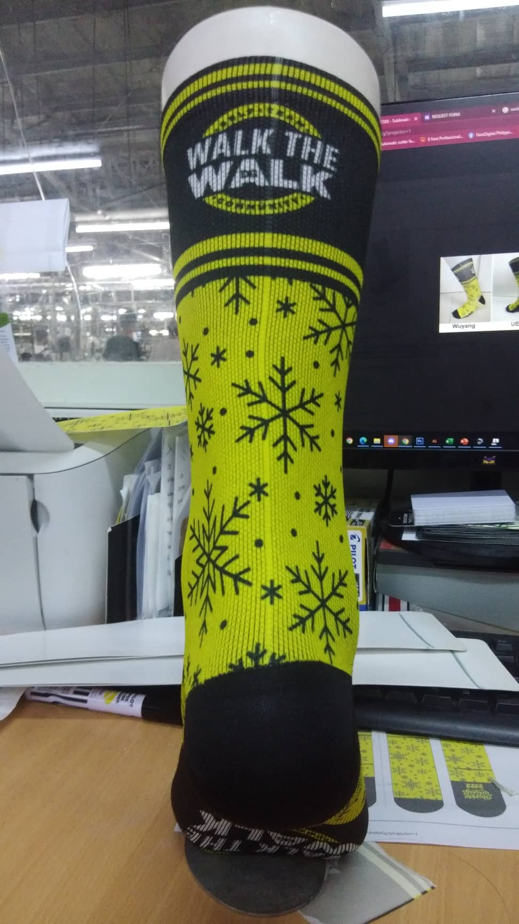
Finish Product

Slide 6
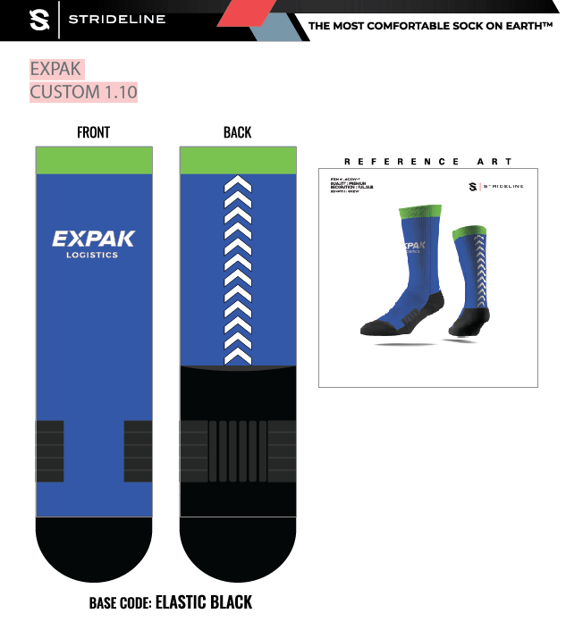
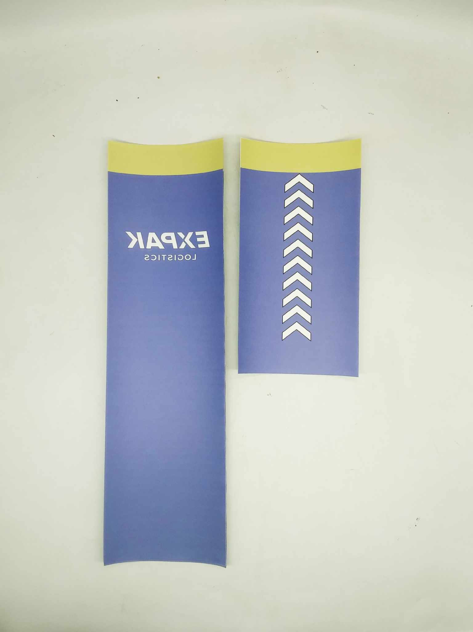
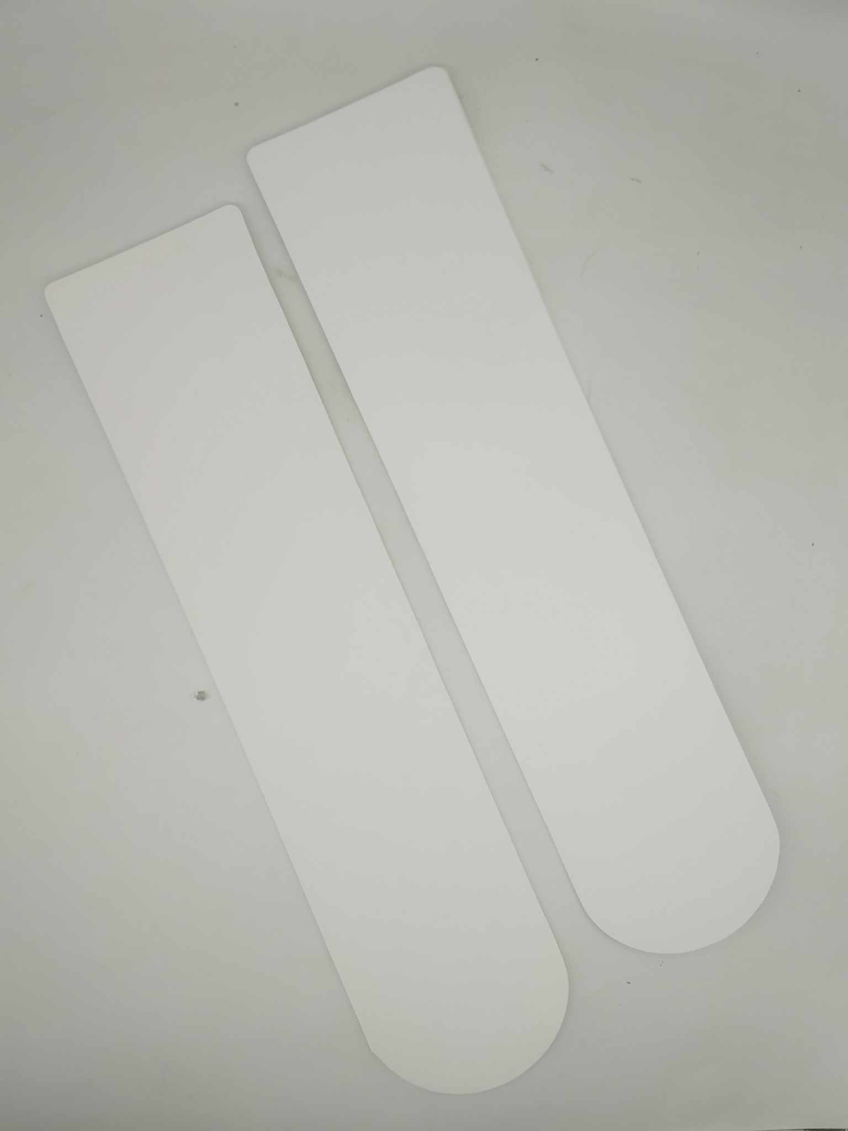
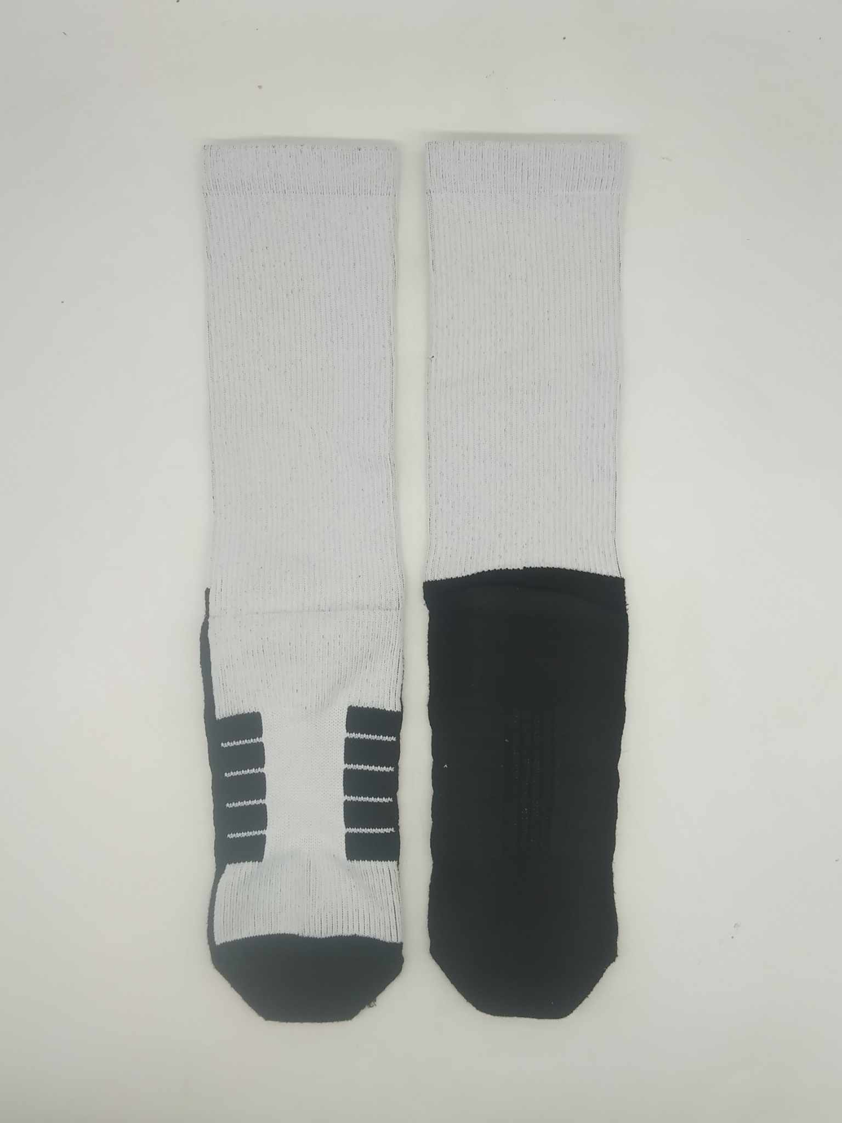
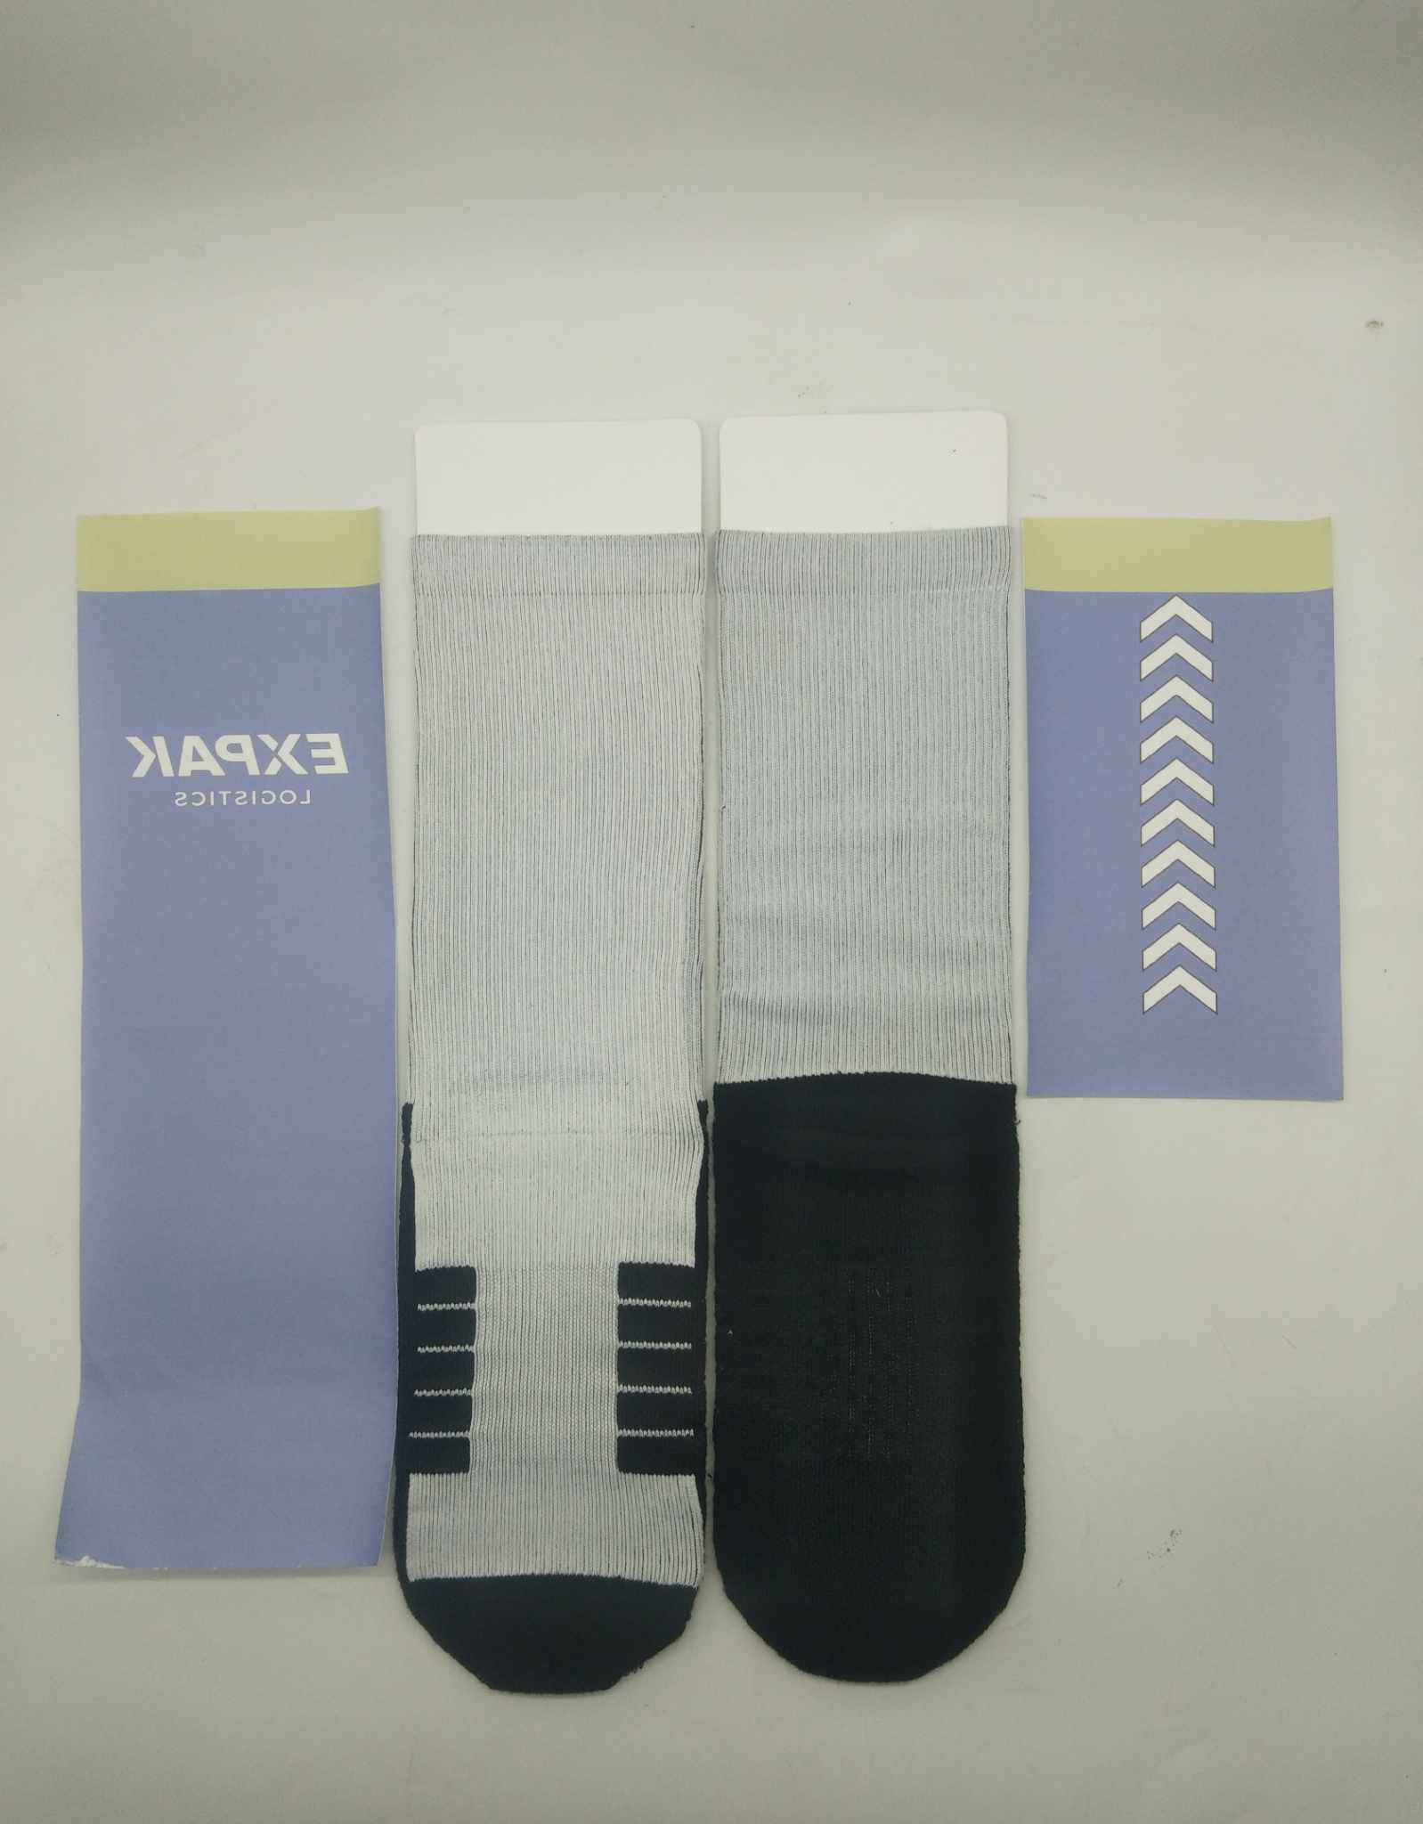
6-CREW SOCKS
STICKER CUT OUT
CARDBOARD JIGS
BLANKS

Slide 7
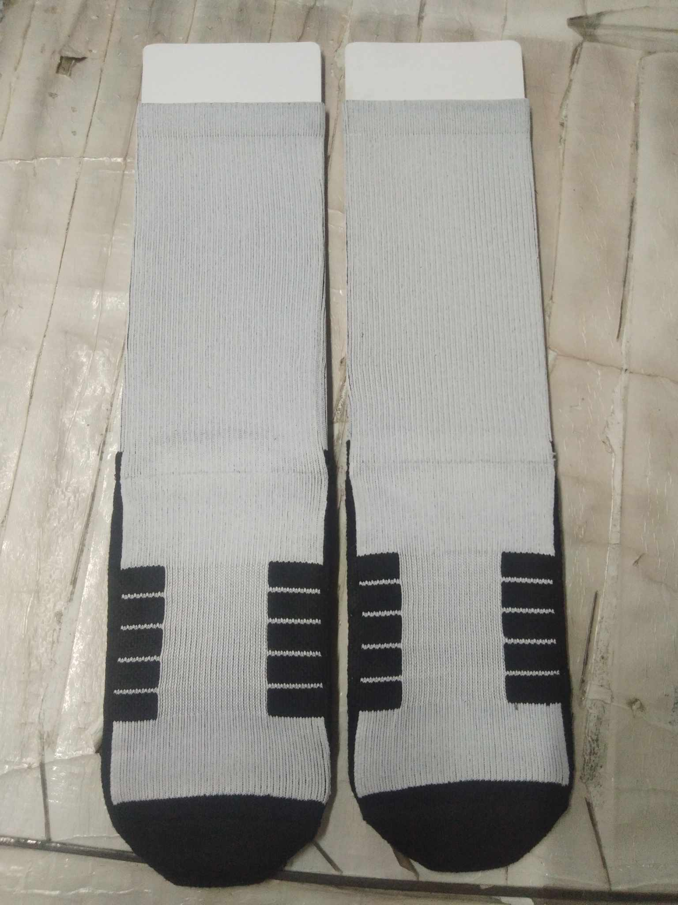
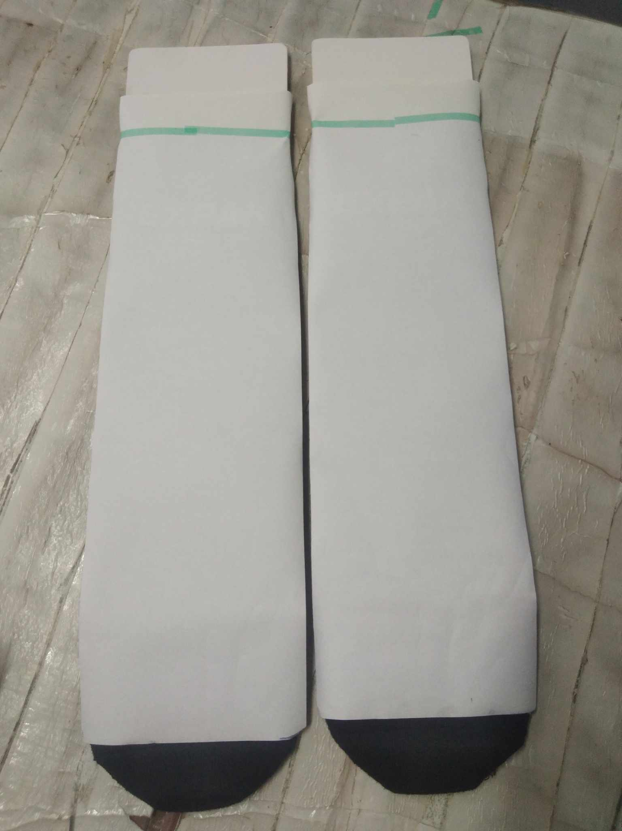
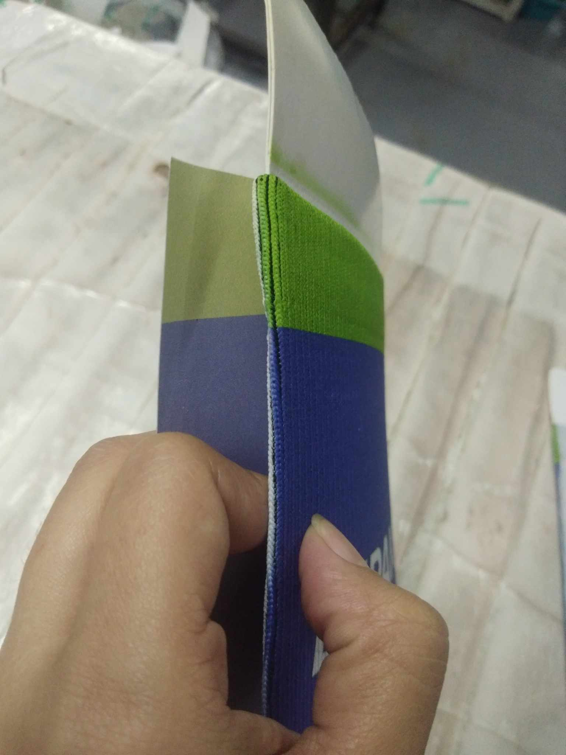
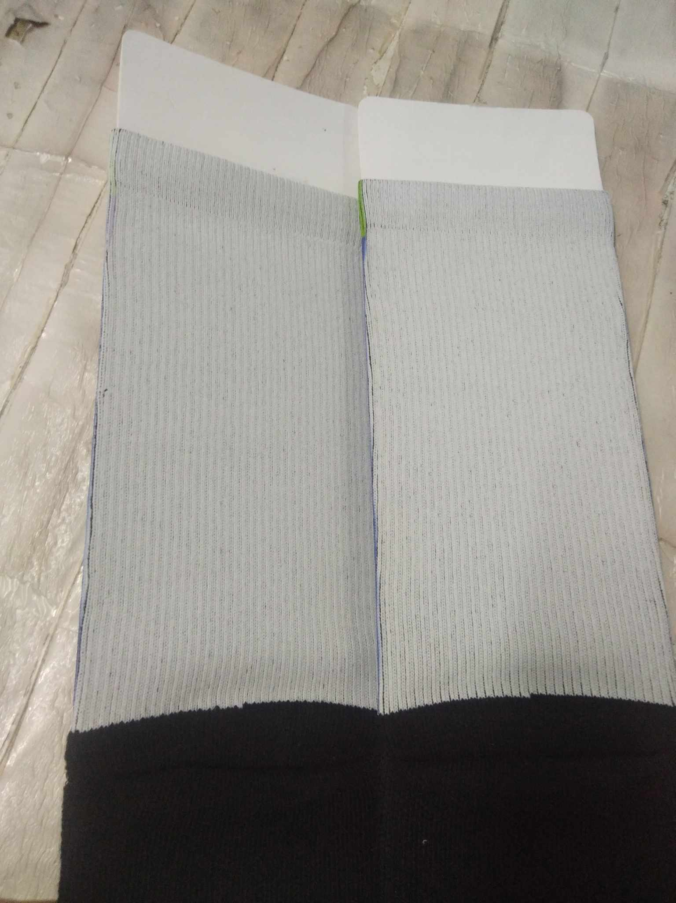
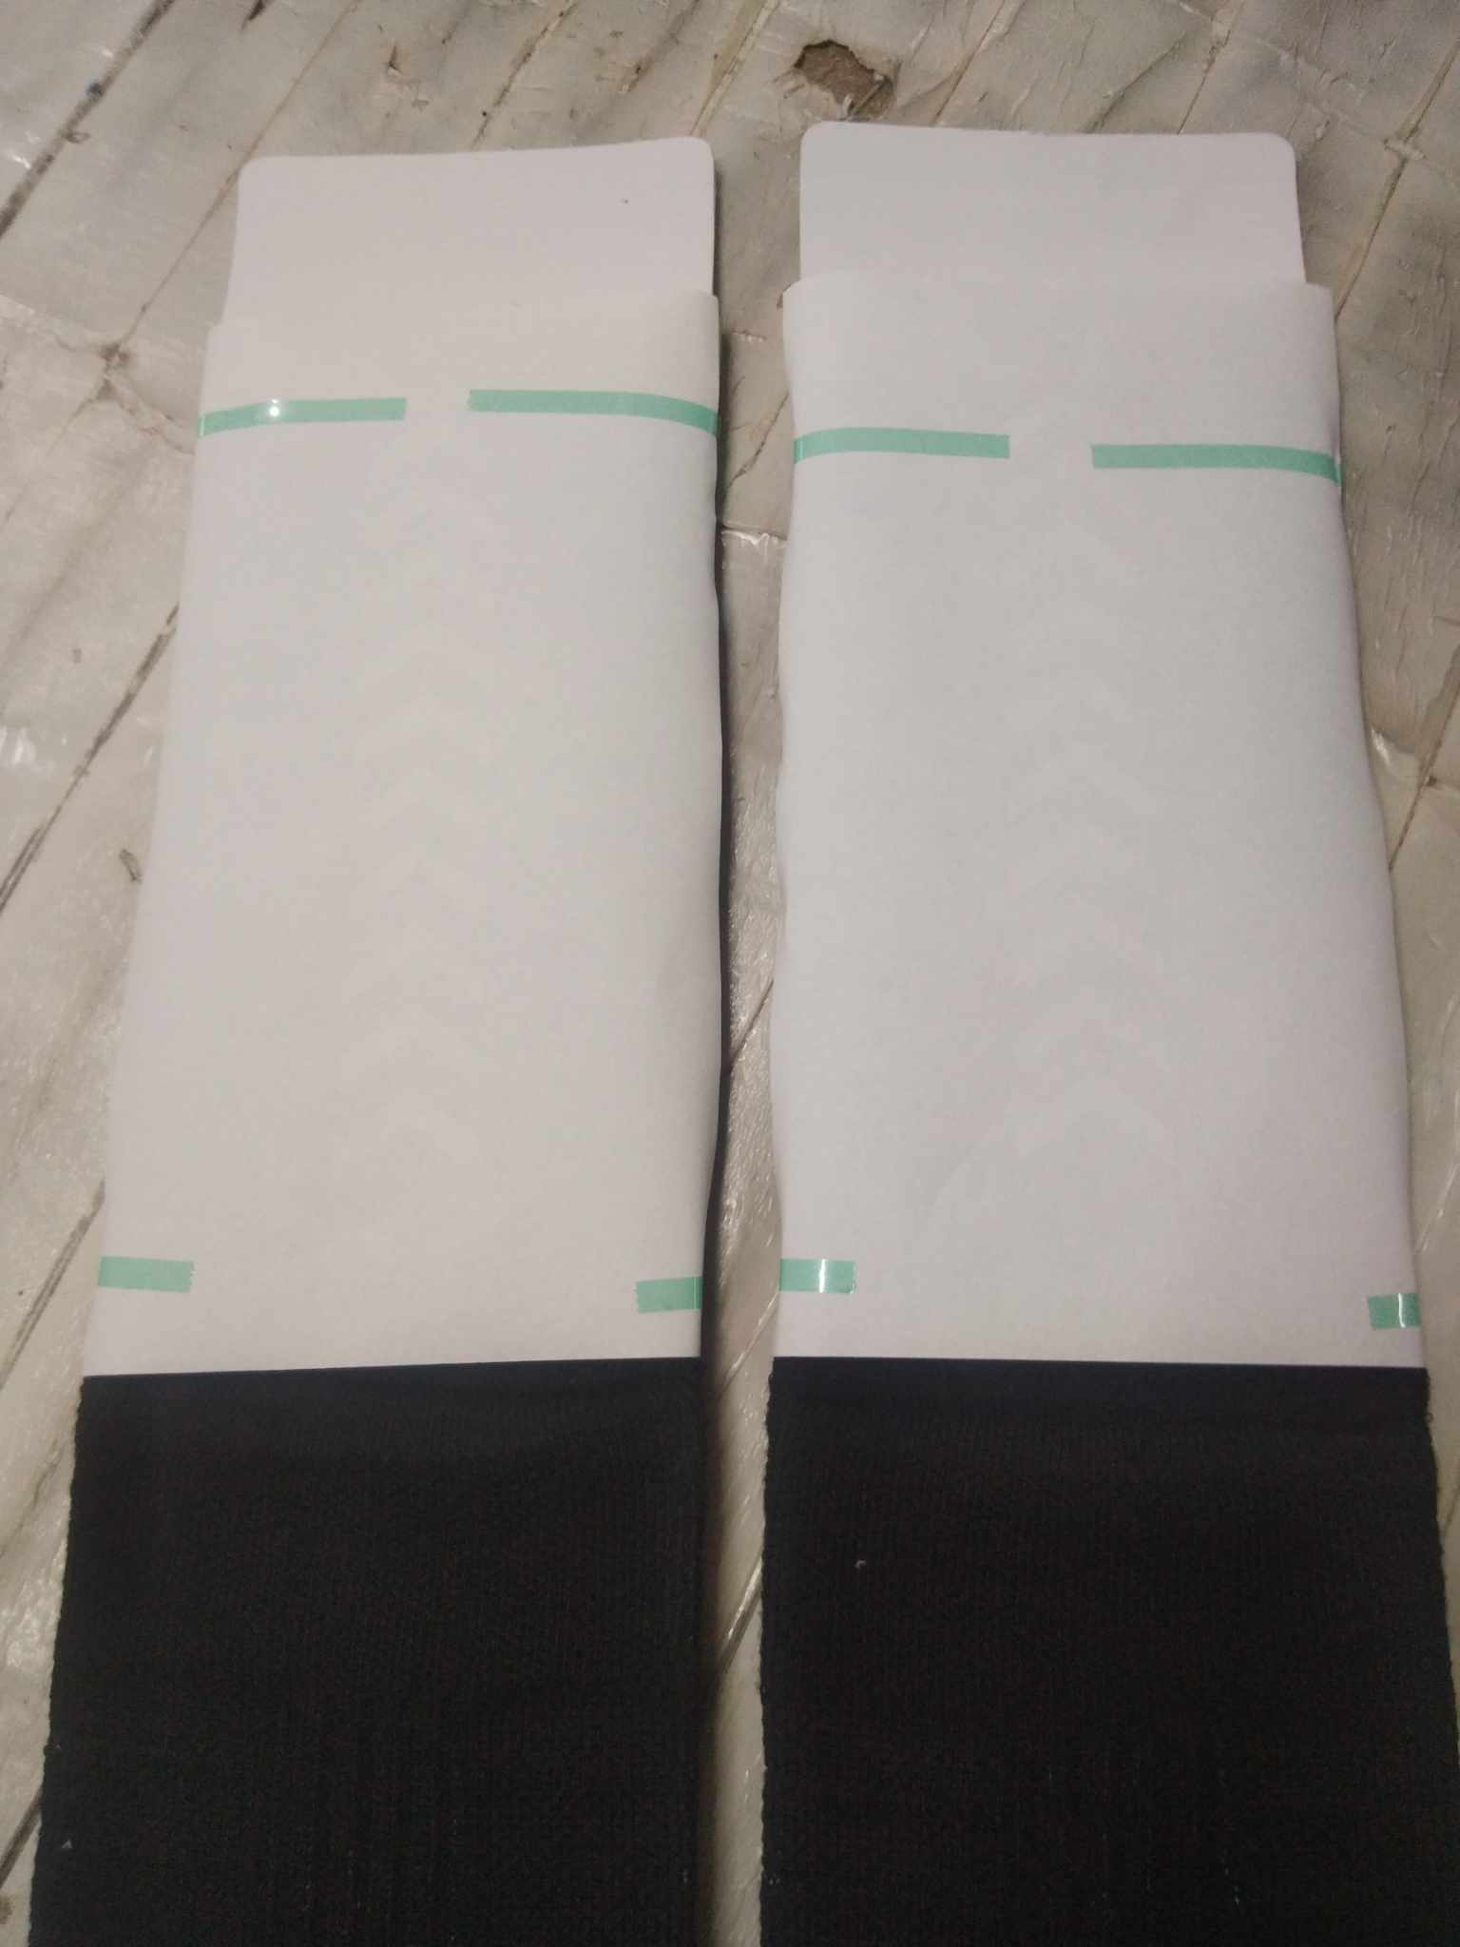
Once the blanks is already in the jig
If it is same size as the sticker
No need to pre-heating
but if it longer
We pre-heating it
for about 2 to 3 sec
1st taping
In making 6crw
We are starting from the front
After the 1st taping pressing then after it has been pressed
We need to switch, flip and roll
Before we proceed in the 2nd taping
We flip it in front a little so that it will not have a white line
We will line up the 2nd sticker, make sure that it will match with the 1st taping.
See the video below:

Slide 8
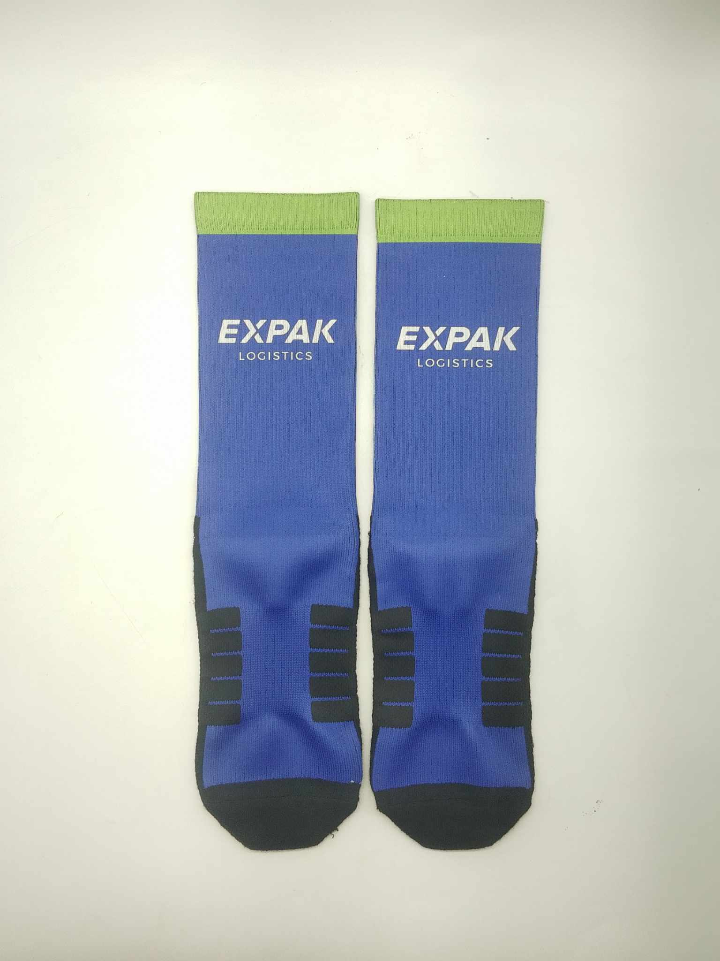
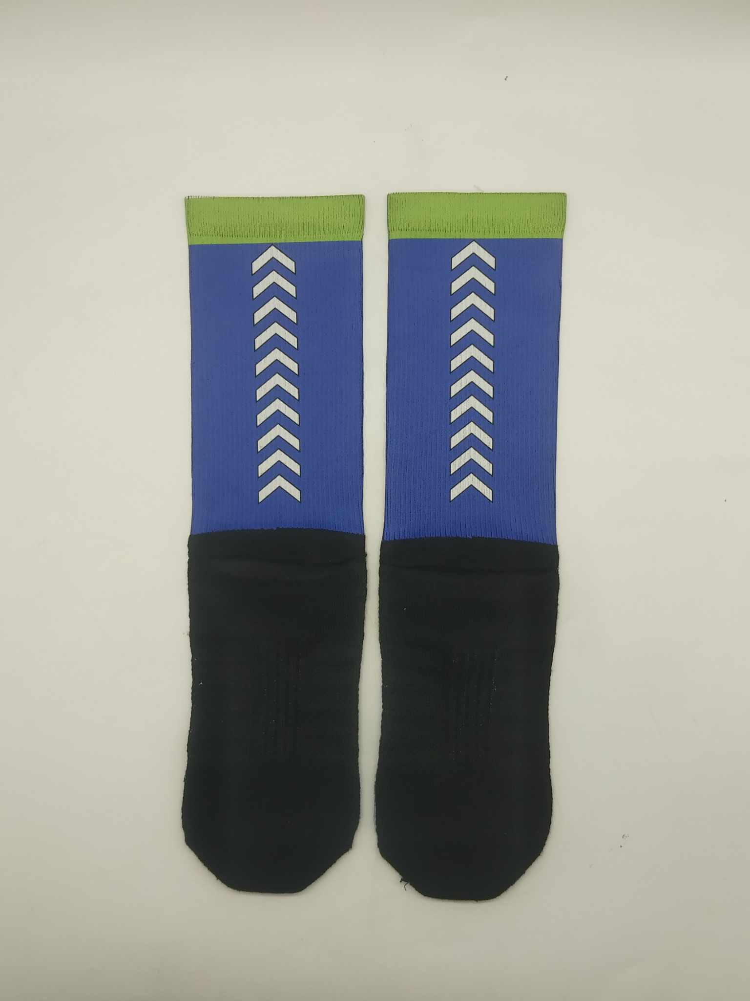
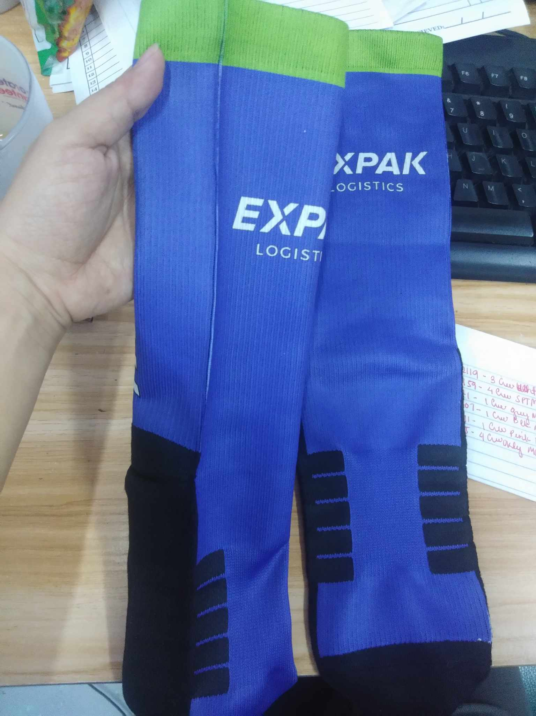
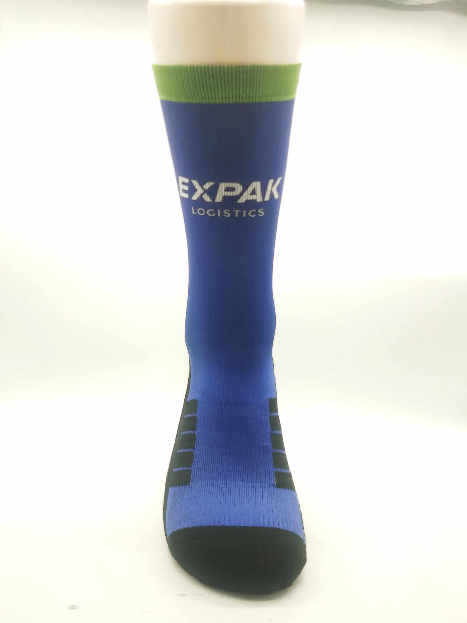
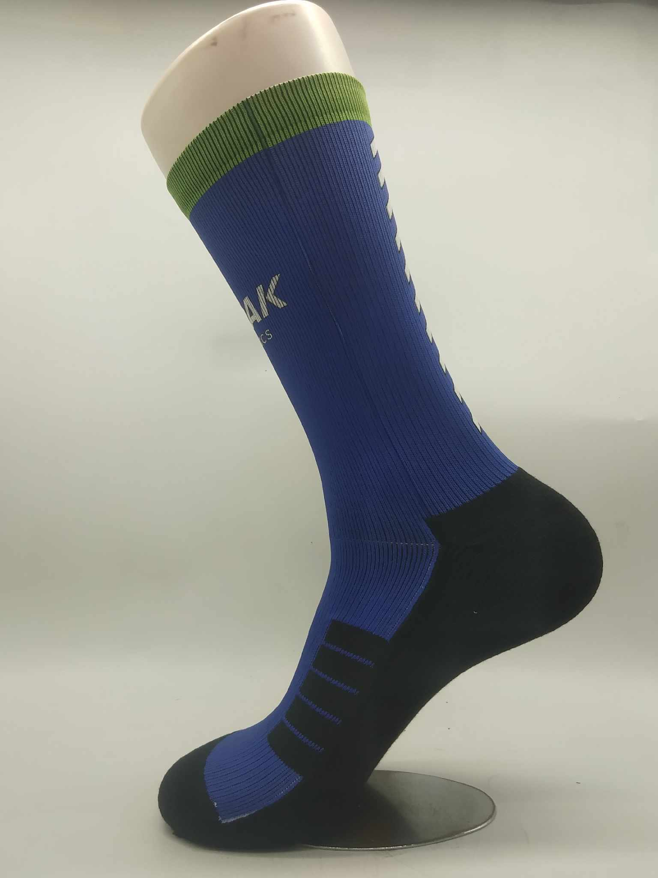
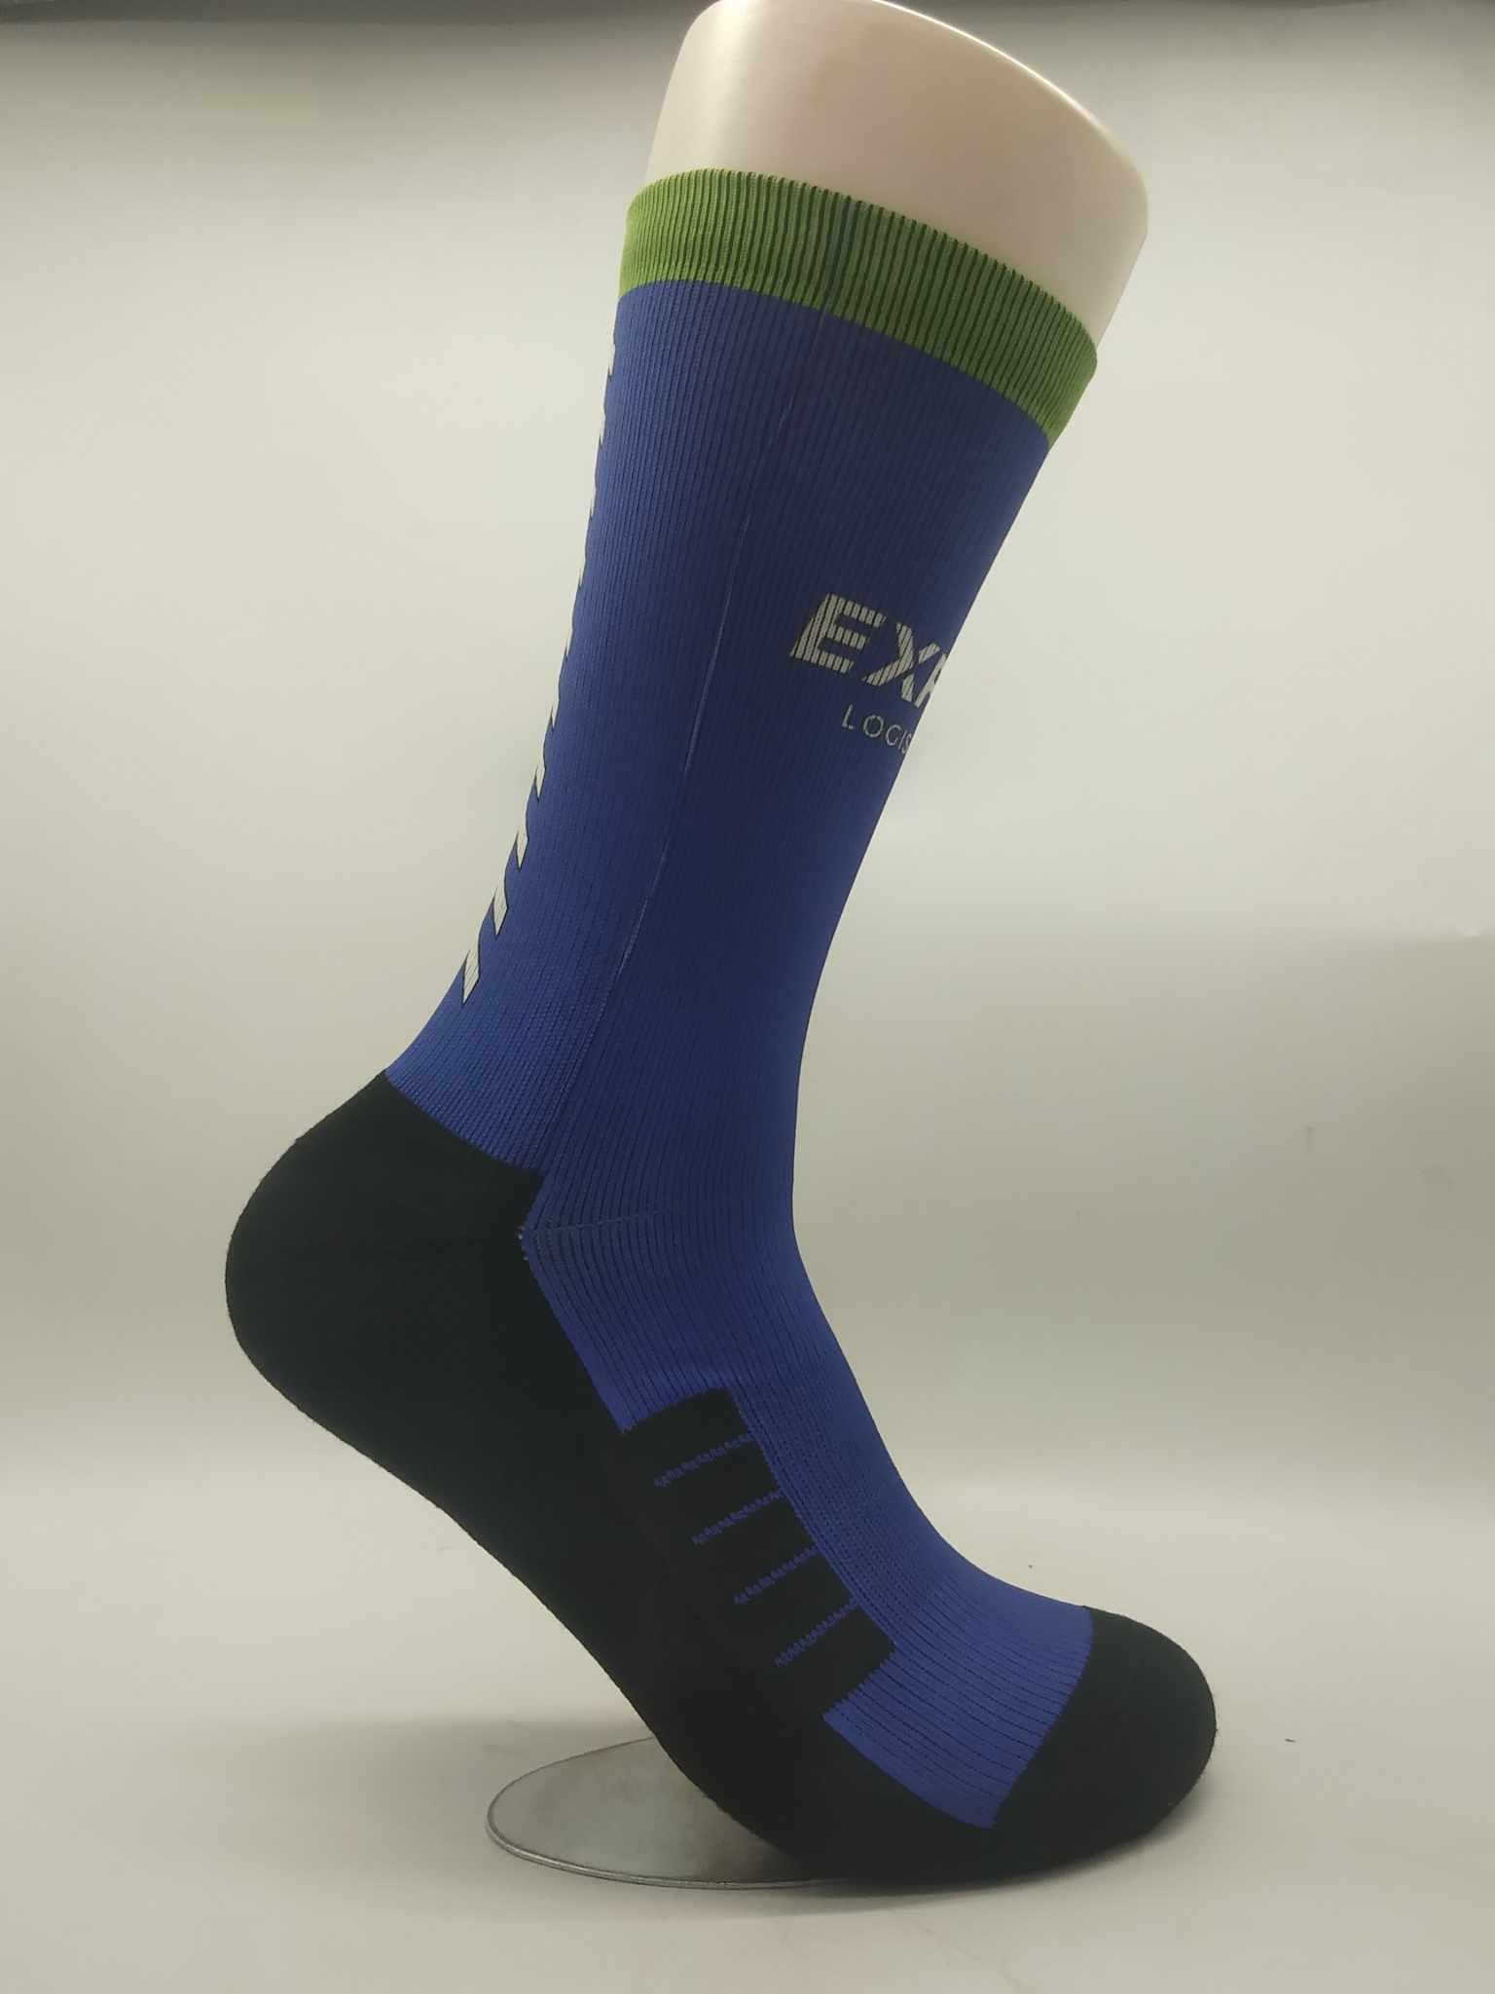
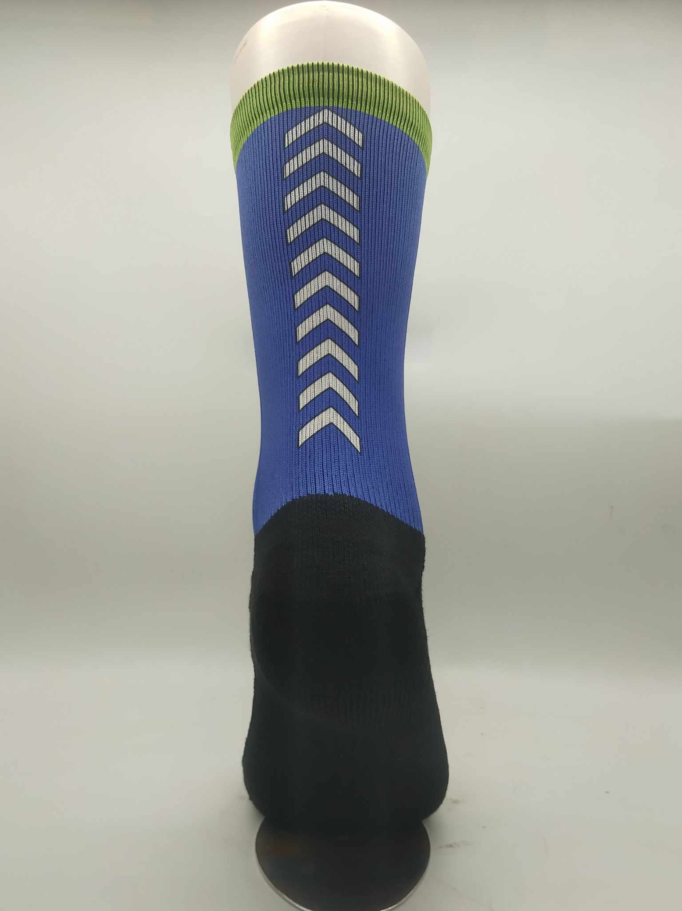
Finish Product

Slide 9
Hope this will help!
If their is something I can help you with just don’t hesitate to message us!

